Slide 1

Intro To Azure RedHat OpenShift
Notes:
This deck is a template for What The Hack lectures.
It is recommended that Coaches deliver mini-lectures ahead of each Challenge that set context for the challenge and introduce & explain any key technologies.
At a minimum, it is handy to have a slide with the key goals of each challenge to display on the screen when running the hack in-person.

Slide 2
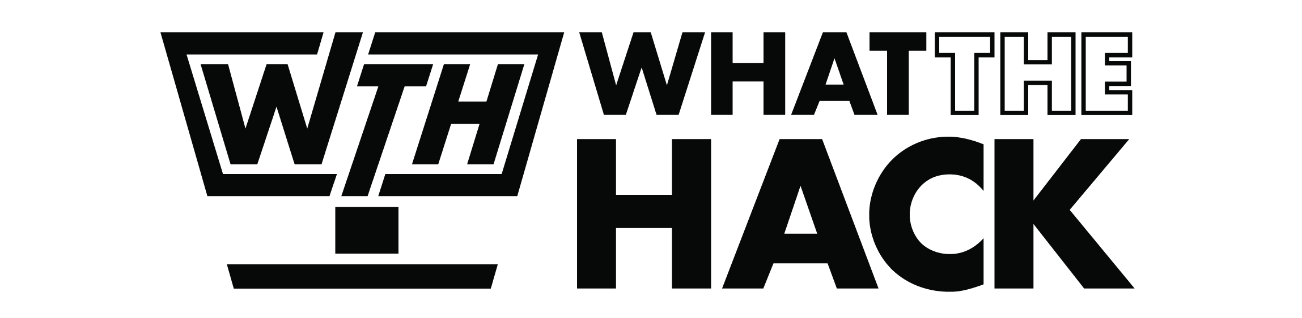
Intro To Azure RedHat OpenShift
Welcome & Intros
<Coach Name>
<Coach Name>
<Coach Title>
<Coach Title>
<Coach Name>
<Coach Name>
<Coach Title>
<Coach Title>
Notes:
Coaches/Presenters for THIS hack/lecture event should be listed on this slide.
Original contributors to the hack content & these slides include:
Please list original contributors to this hack here in the speaker notes and give them credit when delivering this content.
<Original Author 1>
<Original Author 2>
…
<Original Author N>

Slide 3

Challenge Scenario
The customer has an existing web app that they want to modernize and run it with ARO
The application is a smoothie ratings website
Get them to deploy this application onto ARO and operationalize it!
Notes:
Modify this slide and add the pre-reqs specific to your hack here.
Each challenge slide should list the key goals for the challenge.

Slide 4
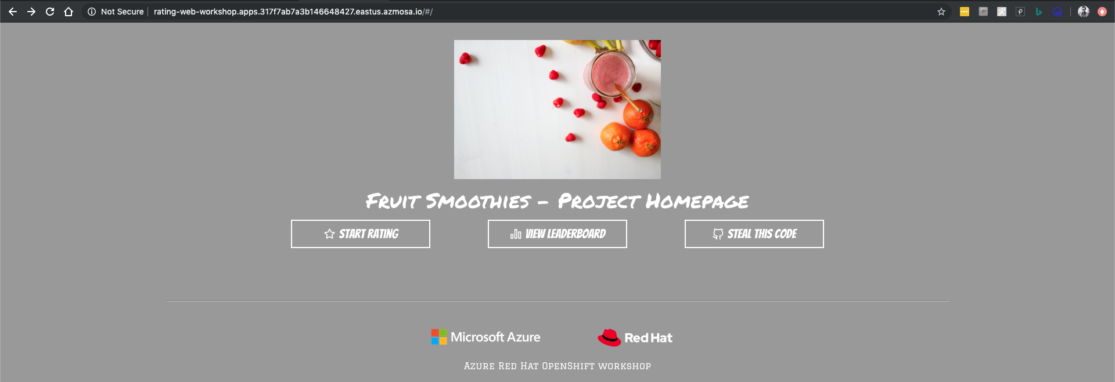
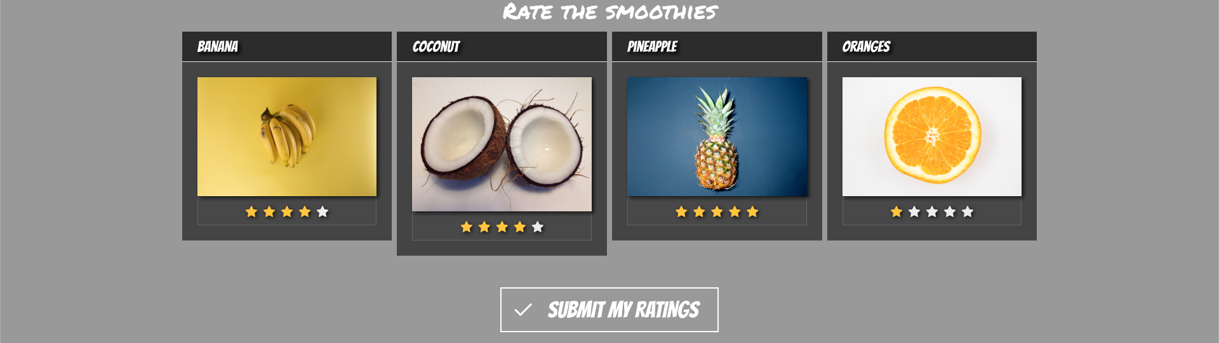
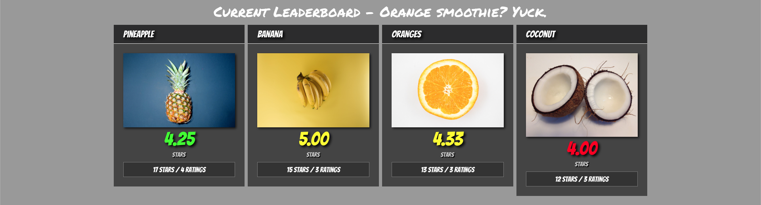
Ratings App
Simple Node.js application
Two components:
rating-api is the public-facing web API
rating-web is the public-facing web frontend
Notes:
Modify this slide and add the pre-reqs specific to your hack here.
Each challenge slide should list the key goals for the challenge.

Slide 5
Journey to ARO Here's our roadmap for the hack
ARO cluster deployment
Application deployment
Logging and Metrics
Storage
Configuration
Networking
Scaling
Azure Active Directory Integration
Azure Key Vault Integration
Notes:
Modify this slide and add the pre-reqs specific to your hack here.
Each challenge slide should list the key goals for the challenge.

Slide 6
Challenge Zero Get your machines ready!
Install Windows Subsystem for Linux (Bash Shell)
Install the Azure CLI (in WSL if on Windows!)
Install Visual Studio Code
Install the OpenShift CLI (Microsoft Docs)
Notes:
Modify this slide and add the pre-reqs specific to your hack here.
Each challenge slide should list the key goals for the challenge.

Slide 7
Kubernetes done right is hard
75% of enterprise users say the complexity of implementation and operations are the top blockers to adoption
Source: The New Stack, The State of the Kubernetes Ecosystem, August 2017
Notes:
What we hear from customers around the world is that their ability to create value for their end customers, both internal and external, depends on your ability to deliver applications faster. ​
​
It’s really your ability to be great at application development and app delivery to differentiate your business, engage customers, and find new ways to create value that could turn into revenue opportunities.​
​
For example, the CEO of Volkswagen says that there are now more than 10 Million lines of code going into the average car, probably more than what’s in your smart phone. ​
Best Buy uses a combination of customer-facing mobile apps, brick-and-mortar and services strategies to thrive in the face of Amazon. ​
And even GE Digital has adopted what they call Kubernetes-as-a-service to enable developers to innovate across their organization.​
​
Containers and Kubernetes fundamentally enable DevOps, microservices and cloud-native application development, and we’d like to think that OpenShift is the best platform to deliver applications across the hybrid cloud.​
​ ​
​

Slide 8
Kubernetes done right is hard
Install
Deploy
Harden
Operate
Templating
Validation
OS Setup
Identity & Security Access
App Monitoring & Alerts
Storage & Persistence
Egress, Ingress & Integration
Host Container Images
Build/Deploy Methodology
Platform Monitoring & Alerts
Metering & Chargeback
Platform Security Hardening Image Hardening
Security Certifications Network Policy Disaster Recovery
Resource Segmentation
OS Upgrade & Patch
Platform Upgrade & Patch Image Upgrade & Patch
App Upgrade & Patch Security Patches Continuous Security Scanning
Multi-environment Rollout
Enterprise Container Registry
Cluster & App Elasticity
Monitor, Alert, Remediate Log Aggregation

Slide 9

Containers come with their own challenges
Container security Image scanning, patching, and compliance
Trusted enterprise Kubernetes Continuous security, world-class support and services and deep expertise to confidently run any application
Day 2 management Install, upgrade, and maintain Integrate existing enterprise technology
A cloud-like experience, everywhere Full-stack and automated operations on a consistent foundation for on-premises or hybrid cloud infrastructures
Application delivery Monitoring, metering, and management Integrate existing developer tools
Empowering developers to innovate Get applications to production sooner with a wide range of technologies and streamlined workflows
Notes:
And the reasons why customers choose OpenShift are reflected in the results of our research. Every time we go out to survey what are some of the issues and challenges that companies face, we hear about 1. Container Security (and compliance), 2. Day 2 mgmt (install, upgrade, etc), and 3. App dev & mgmt.
On the other hand, prospects are looking for a vendor with demonstrated leadership and contributions to open source communities, platform security and long-term commercial support… that’s Red Hat! That’s what we do. That’s our business.
My question to you is: where are you in your container adoption journey, what technologies are you looking at currently, and what do you consider critical capabilities in your selection process, in terms of both product and vendor capabilities?
Here is how we address container adoption challenges in OpenShift, and what is the value that OpenShift provides in each of these categories.
We take container security very seriously and take a holistic approach to deliver what we call a trusted enterprise Kubernetes platform. As you know, containers are Linux, and so is Kubernetes. And because we also provide RHEL which is trusted by 1,000s of Enterprises worldwide we can deliver a secure platform across the stack and stand behind it with long-term support.
We recognize that keeping up with the frequent upstream releases can be challenging and we’re investing in automated capabilities like the operator framework and over-the-air updates to make it easier to keep up to date with the latest innovations coming out of the communities and to deploy containers at scale.
It’s all about the developers and we’re investing in (1) automation capabilities in OpenShift, e.g. CICD pipelines, AB testing etc, (2) developer tools like Codeready Workspaces and (3) cloud-native frameworks including Spring, serverless and Windows containers to inspire developers to create the best code. No matter what applications you’re building, chances are you can improve developer productivity with OpenShift.

Slide 10

OpenShift in Azure
Notes:
For each “mini-lecture”, have a topic title and/or sub-topic title.
Each mini-lecture should be no longer than 5-10 minutes in length.
Only deliver one lecture ahead of each challenge.
Do not attempt to present all of the lectures before students start hacking.

Slide 11
RedHat OpenShift in Azure Managed & Unmanaged
OpenShift Container Platform on Virtual Machines
Deploy through cloud.redhat.com/openshift
Self-managed on infrastructure as a service (IaaS)
Bring your own license
Azure Red Hat OpenShift
Deployed through the Azure Portal or the Azure CLI
Fully-managed and supported Red Hat OpenShift platform
Billing integrated in your Azure subscription

Slide 12
RedHat OpenShift in Azure Unmanaged
Responsibilities
User management
Project and quota management
Application lifecycle
Cluster creation
Cluster management
Monitoring and logging
Network configuration
Software and security updates
Platform support
Customer
Microsoft and Red Hat
Notes:
In a traditional Red Hat OpenShift Container Platform deployment, you need to deploy and manage a lot of supporting infrastructure.
You end up managing a lot of things yourself, from cluster creation, network configuration, monitoring and logging, to securing, patching and updating the cluster.
This takes time and effort.

Slide 13
RedHat OpenShift in Azure Managed – ARO (Azure RedHat OpenShift)
Responsibilities
User management
Project and quota management
Application lifecycle
Cluster creation
Cluster management
Monitoring and logging
Network configuration
Software and security updates
Platform support
Manage all your clusters
Monitor and operate your VMs
Secure your nodes
Manage environment patches
Let Microsoft and RedHat…
Customer
Microsoft and Red Hat
Notes:
With Azure Red Hat OpenShift, our aim was to simplify the cluster operations so that you focus on building, deploying and scaling apps with confidence.
Microsoft and Red Hat manage all the cluster infrastructure, apply security best practices, monitor and operate the VMs.

Slide 14
What is Azure RedHat OpenShift (ARO) ?
Notes:
For each “mini-lecture”, have a topic title and/or sub-topic title.
Each mini-lecture should be no longer than 5-10 minutes in length.
Only deliver one lecture ahead of each challenge.
Do not attempt to present all of the lectures before students start hacking.

Slide 15

What is ARO? ARO Overview
Jointly engineered, operated, and supported by both Microsoft and Red Hat with an integrated support experience
Red Hat OpenShift is an enterprise-ready Kubernetes container platform with full-stack automated operations to manage hybrid and multi-cloud deployments
Highly available and fully managed
Notes:
Template for a lecture slide with bullets (if you need them).
Try to NOT use bullet lists in your presentation.
Diagrams, puppy pictures, etc are always better. ☺

Slide 16
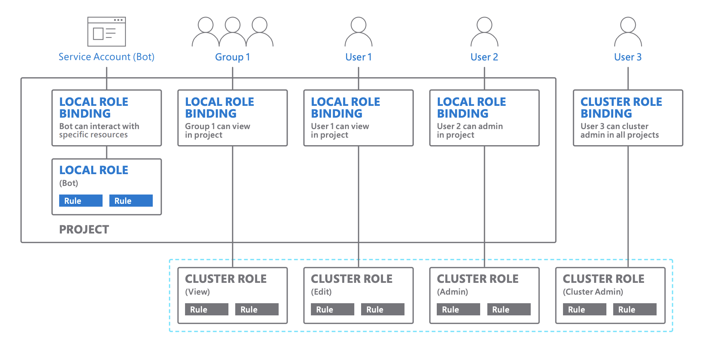
What is ARO? ARO Security
Notes:
Template for a lecture slide with bullets (if you need them).
Try to NOT use bullet lists in your presentation.
Diagrams, puppy pictures, etc are always better. ☺

Slide 17
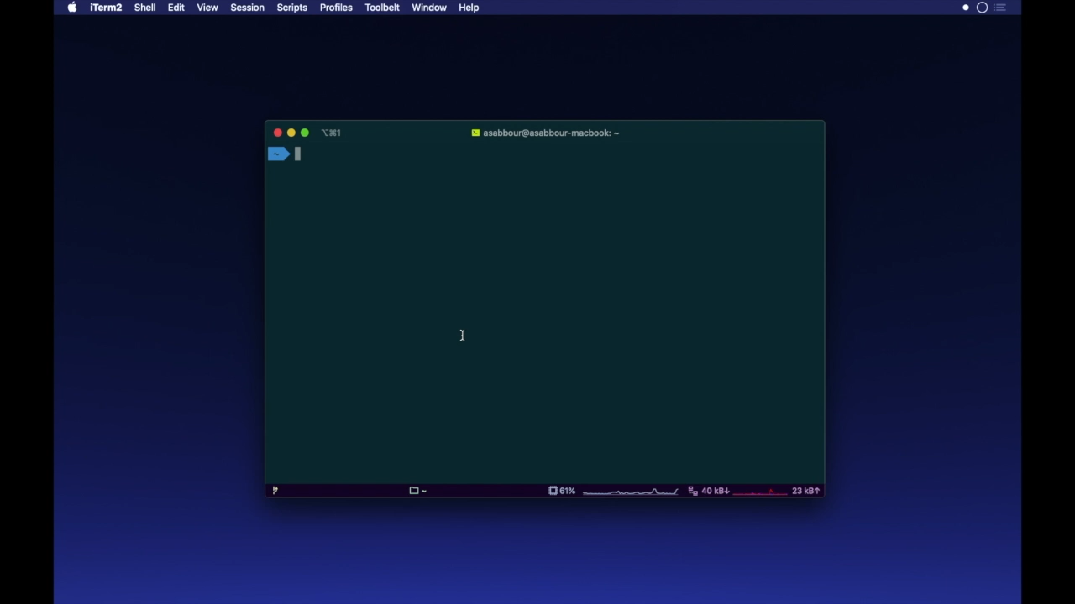
What is ARO? Deployment
Notes:
Template for a lecture slide with bullets (if you need them).
Try to NOT use bullet lists in your presentation.
Diagrams, puppy pictures, etc are always better. ☺

Slide 18
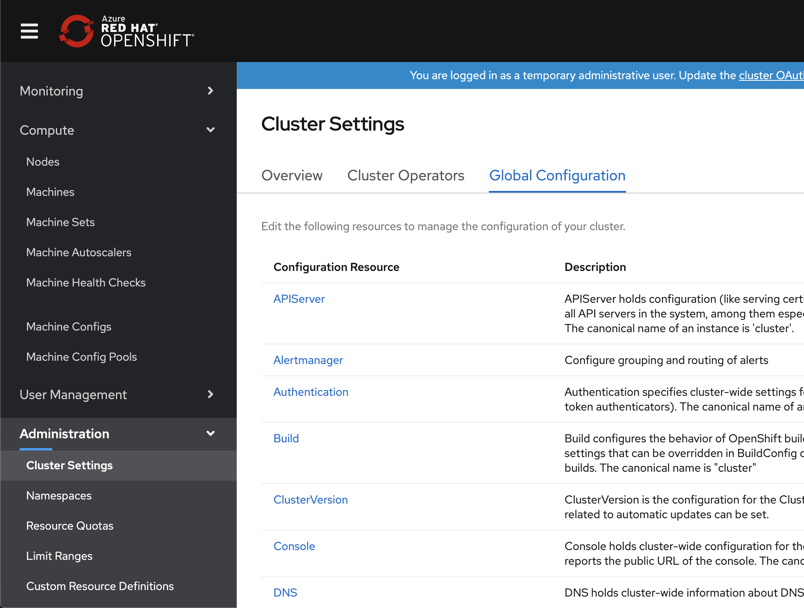
What is ARO? Administration
Administrators have full cluster-admin role. They’re able to configure running privileged containers and installing Custom Resource Definitions (CRDs).
Notes:
Template for a lecture slide with bullets (if you need them).
Try to NOT use bullet lists in your presentation.
Diagrams, puppy pictures, etc are always better. ☺

Slide 19

What is ARO? Integrated Developer Workflow
Build
Test
Deploy
Self-service Provisioning
Consistent
environments
Automated
build & deploy
CI/CD pipelines
Configuration management
App logs & metrics
Code
Review
Monitor
Spring & Java EE
Microservices
Functions
Languages
Databases
Application services

Slide 20
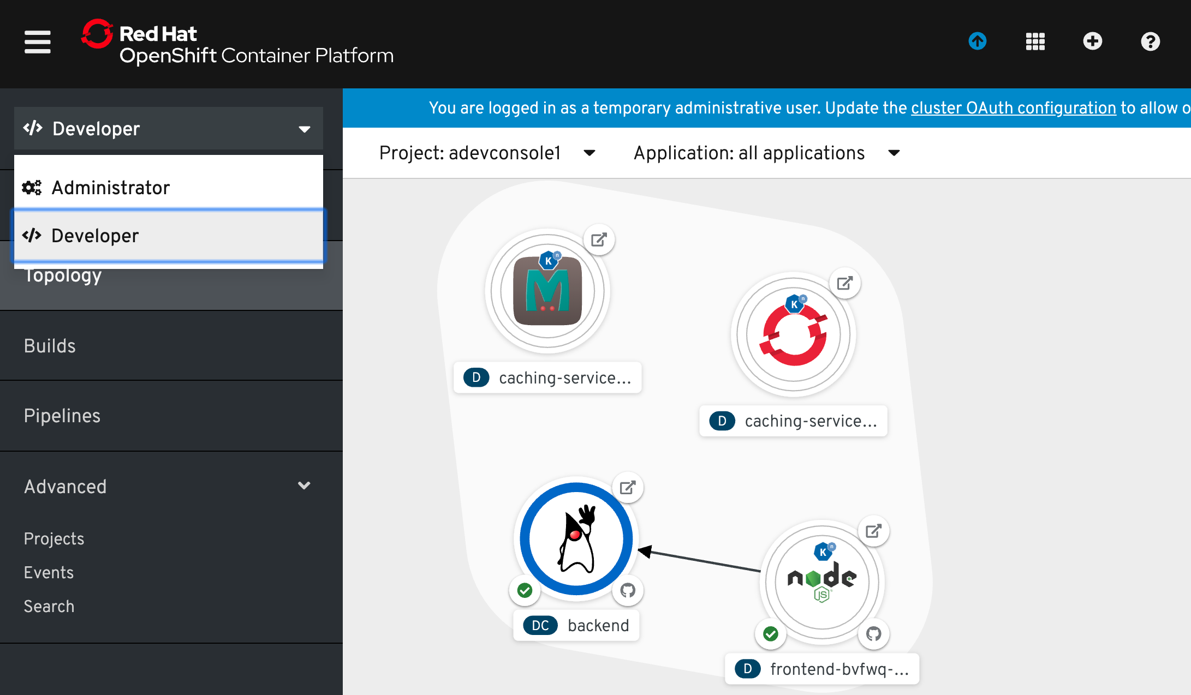
What is ARO? Developer Console
Streamlined console A developer centric perspective that offers a simplified view of Kubernetes concepts so developers can focus on what really matters
Create and manage applications Import source from Git, view and manage app configuration and workload details, and deploy applications
Application topology View structure and status of app components, drill into component connections and workload details, quickly navigate to pod logs
Notes:
Kubernetes is only one part of a container platform, and often it is the infrastructure administrators that are responsible for managing the platform. And that means that Kubernetes APIs were designed to solve infrastructure problems first, not tailored for developers. which means that developers are forced to interact with the platform in a way that isn’t intuitive to the way they usually think. The latest release of Red Hat OpenShift Container Platform changes all that—delivering the most powerful and holistic developer experience yet. A new, streamlined web console provides a developer-centric perspective that aligns closer to how they work. It offers a simplified view of Kubernetes concepts so developers can focus on what really matters when creating applications.
The console allows developers to import their source code from Git, view and manage app configuration and workload details, and deploy their applications, all through this dedicated interface.
Built-in application topology views let users zoom in and review and edit an app’s structure, component connections, workload details, builds, routes, and source

Slide 21


What is ARO? Developer Productivity
CodeReady Workspaces
Web-based IDE (Eclipse Che) Collaborative development Integrated with CI/CD
OpenShift ODO Advanced developer CLI
Plugins
Integration plugins – Visual Studio Code, Azure Pipelines, GitHub Actions, Eclipse IDE, JetBrains
CodeReady Workspaces
Developer
ODO
Visual Studio Code
Azure Pipelines
Eclipse
JetBrains
Notes:
As we discussed before, OpenShift supports a very broad range of application types and frameworks.
Service Mesh and Serverless are exciting technologies that make it easier to build and run microservices architectures and we support both in OpenShift 4.
Service Mesh provides networking capabilities at the application layer so that application components can discover services and communicate with one another. OpenShift also supports monitoring and tracing of inter-application network traffic using Kiali, Jaeger and Istio framework underneath.
Serverless is less mature at this stage and we have announced support for a number of event sources on the knative framework including Azure Functions, OpenWhisk and Camel K.

Slide 22
What is ARO? Developer Productivity
A fast, iterative, and straightforward CLI tool for developers who write, build, and deploy applications on OpenShift.
Existing tools are more operations-focused and require a deep-understanding of Kubernetes and OpenShift concepts.
Odo (OpenShift Do) abstracts away complex Kubernetes and OpenShift concepts for the developer, thus allowing developers to focus on what is most important to them: code.
$ odo create wildfly backend
Component ‘backend’ was created.
$ odo push
Pushing changes to component: backend
$ odo create php frontend
Component ‘frontend’ was created.
To push source code to the component run ‘odo push’
$ odo push
Pushing changes to component: frontend
$ odo url create
frontend - http://frontend-myapp.192.168.99.100.nip.io
$ odo watch
Waiting for something to change in /dev/frontend

Slide 23
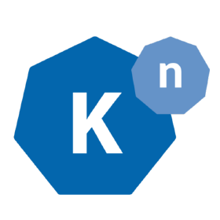




What is ARO? nextGen Apps
OpenShift Serverless (Tech Preview)
Integrated serverless, enabling scale-to-zero function-based apps and event sources – built on the Knative framework.
Support for Azure Functions
Integrated with Camel-k for rich set of initial event sources: HTTP, Kafka, AMQP
OpenShift Service Mesh
Integrated service mesh for enhanced security and network segmentation of microservices applications. Combines Istio, Kiali (UI), and Jaeger (Tracing) projects.
OpenShift
Serverless
OpenShift Service Mesh
Notes:
As we discussed before, OpenShift supports a very broad range of application types and frameworks.
Service Mesh and Serverless are exciting technologies that make it easier to build and run microservices architectures and we support both in OpenShift 4.
Service Mesh provides networking capabilities at the application layer so that application components can discover services and communicate with one another. OpenShift also supports monitoring and tracing of inter-application network traffic using Kiali, Jaeger and Istio framework underneath.
Serverless is less mature at this stage and we have announced support for a number of event sources on the knative framework including Azure Functions, OpenWhisk and Camel K.

Slide 24
ARO vs AKS
Notes:
For each “mini-lecture”, have a topic title and/or sub-topic title.
Each mini-lecture should be no longer than 5-10 minutes in length.
Only deliver one lecture ahead of each challenge.
Do not attempt to present all of the lectures before students start hacking.

Slide 25
OpenShift vs Kubernetes Differences
Red Hat OpenShift is a Kubernetes container platform and is often referred to as “Enterprise Kubernetes”
Differences between Kubernetes and ARO:
Ease of deployment: ARO automates the heavy lifting and backend work, so you only need to create a project and upload code
Security: Included security features, so ARO handles things like name-spacing and creating different security policies
Day to day operations: Cluster provisioning, scaling, and upgrade operations are automated and managed by the platform

Slide 26
ARO vs AKS Infrastructure
 | AKS | ARO
Versions​ | Kubernetes 1.25.6 (default), 1.26.3 (Preview) - as of May 25th , 2023 | Follows OpenShift Container Platform releases.​ OCP 3.11 (Kubernetes 1.11), OCP 4.3 (Kubernetes 1.16), OCP 4.4 (Kubernetes 1.17)​
Cluster Size​ | 5000 nodes | 60 nodes (define multiple MachineSets), Minimum cluster is of 3 Master (D8s v3) and 3 App Nodes (D4s v3)​
Node Types​ | Spot VMs, Virtual Node support (ACI connector)​ Broad range of VM series including GPU/HPC​ | Master Nodes – Ds v3 series​ App Nodes – Das v4, Ds v3, , Es v3, Fs v2 series​
Worker OS​ | Linux (Ubuntu – 16.04 GA, 18.04 Preview), Windows (Server 2019)​ | Linux (RHEL) – 3.11, Linux (RHCOS) – 4.x​
Networking​ | VNET peering, Express Route, Private Cluster with Private link, Authorized IP Ranges, Azure CNI or Kubenet network mdoels with Network Policy support (Azure, Calico)​ | VNET peering, Express Route, Private Cluster with Private link, OpenShift SDN CNI (overlay network with Open vSwitch) with Network Policy support ​
External Load Balancing​ | Azure Standard LB, Azure Basic LB, Azure App Gateway​ | Azure Standard LB​
Storage​ | Azure Disk (default) and Azure Files for PVs​ | Azure Disk (default) and Azure Files for PVs​
Cluster Automation​ | ARM, Terraform, AZ CLI, Ansible​ | AZ CLI​

Slide 27
ARO vs AKS Operations
 | AKS | ARO
Cluster Creation​ | ARM, Azure CLI, Terraform, Ansible​ Create cluster in < 10 mins​ | Azure CLI​ Create cluster in ~ 35 mins​
OS Updates​ | Automatic OS update for worker nodes (Linux only - customer responsible for reboots), Node Image Upgrades (preview)​ | We auto upgrade nodes when new patch versions available (major.minor.PATCH)​ Reboots are part of upgrade (service provider responsible)​
Cluster Upgrades​ | Kubernetes releases available within ~30 days of upstream release, upgrade entire cluster, control plane-only, node pool only, node max surge​ | Customers manually update the minor version using over-the-air upgrades (major.MINOR.patch)​ Major versions considered a migration (MAJOR.minor.patch)​
Scaling​ | Scale to 1 node for System node pool, Scale to 0 nodes for User node pools, Cluster AutoScaler, Horizontal Pod Autoscaler​ | MachineAutoscaler/ClusterAutoscaler, MachineSets, Horizontal Pod Autoscaler​
Administration​ | kubectl, Kubernetes Dashboard (integrated add-on), 3pp/OSS (e.g. Octant). CICD and GitOps.​ | OCP web console, “oc” CLI​ CICD and GitOps.​
Security​ | Azure AD Integration, Pod Identity, Azure Policy integration, KV Secrets CSI Driver, etcd encryption (Azure managed), Data encryption at rest (Microsoft or BYOK), Network Policy (Azure, Calico)​ | SCC for enhanced security, BYO Identity Provider (Azure AD via OpenID Connect), etcd encryption (optional), Data encryption at rest (Microsoft), Network Policy (OpenShift SDN CNI)​
Package Management​ | Helm is the default.​ Install operators from https://operatorhub.io/​ | Integrated OperatorHub and Red Hat Certified Operators for Day 1 and Day 2 management​
Monitoring & Logging​ | Azure Monitor integrated add-on.​ Supports scraping Prometheus metrics.​ | Prometheus Operator (installed by default), Cluster Logging & Elasticsearch Operator, zAzure Monitor (preview, self-install)​
Notes:
Template for a lecture slide with bullets (if you need them).
Try to NOT use bullet lists in your presentation.
Diagrams, puppy pictures, etc are always better. ☺

Slide 28
ARO vs AKS App Development
 | AKS | ARO
CI/CD Pipelines​ | Azure DevOps Kubernetes tasks and Kubernetes environment (YAML), GitHub Actions for Kubernetes​ | OpenShift pipelines - Tekton (integrated), Source2Image, Can integrate with Azure DevOps and GitHub Actions​
Registry​ | Options - Azure Container Registry (private), DockerHub (public)​ | Integrated – OpenShift Container Registry​ Options - Azure Container Registry, Red Hat Quay​
Dev Software Packages​ | Find Helm Charts on https://hub.helm.sh/ and install with Helm CLI​ | Template/Operator Hub to install software packages needed by devs. Helm Charts also supported.​
Ingress Routing​ | App Gateway Ingress Controller (add-on), HTTP application routing (add-on), 3pp/OSS Ingress Controllers (e.g. NGINX, Traefik)​ | Routes (built-in) with added capabilities over Ingress​
Troubleshooting​ | SSH into Worker nodes, AKS Diagnostic Reports, AKS Diagnostic Logs, “kubectl” stream logs​ | OCP admin/developer console, Prometheus, “oc” stream logs​ oc debug​
Developer Tools​ | Bridg for Kubernetes for rapid development and debugging​ | Red Hat CodeReady Containers, “odo” CLI, Developer Perspective in OCP web console, Open source development frameworks and tools from Red Hat Runtime​
IDE Support​ | AZD, VSCode integration via Kubernetes extension​ | OpenShift Connector for VSCode​ Red Hat CodyReady/Eclipse Che (Operator)​
Service Mesh​ | None integrated – AKS docs cover Istio, Linkerd, Consul Connect​ | OpenShift Service Mesh (Istio) Operator​
Serverless FaaS​ | KEDA for event-driven workloads and scaling (including Azure Functions)​ | OpenShift Serverless (Knative) Operator, KEDA Operator​
Notes:
Template for a lecture slide with bullets (if you need them).
Try to NOT use bullet lists in your presentation.
Diagrams, puppy pictures, etc are always better. ☺

Slide 29
ARO vs AKS Security & Compliance
 | ARO | AKS
CI/CD Pipelines​ | Azure DevOps Kubernetes tasks and Kubernetes environment (YAML), GitHub Actions for Kubernetes​ | OpenShift pipelines - Tekton (integrated), Source2Image, Can integrate with Azure DevOps and GitHub Actions​
Registry​ | Options - Azure Container Registry (private), DockerHub (public)​ | Integrated – OpenShift Container Registry​ Options - Azure Container Registry, Red Hat Quay​
Dev Software Packages​ | Find Helm Charts on https://hub.helm.sh/ and install with Helm CLI​ | Template/Operator Hub to install software packages needed by devs. Helm Charts also supported.​
Ingress Routing​ | App Gateway Ingress Controller (add-on), HTTP application routing (add-on), 3pp/OSS Ingress Controllers (e.g. NGINX, Traefik)​ | Routes (built-in) with added capabilities over Ingress​
Troubleshooting​ | SSH into Worker nodes, AKS Diagnostic Reports, AKS Diagnostic Logs, “kubectl” stream logs​ | OCP admin/developer console, Prometheus, “oc” stream logs​ oc debug​
Developer Tools​ | Azure Dev Spaces & Azure Dev Spaces Connect for rapid development and debugging​ | Red Hat CodeReady Containers, “odo” CLI, Developer Perspective in OCP web console, Open source development frameworks and tools from Red Hat Runtime​
IDE Support​ | VSCode integration via Kubernetes extension​ | OpenShift Connector for VSCode​ Red Hat CodyReady/Eclipse Che (Operator)​
Service Mesh​ | None integrated – AKS docs cover Istio, Linkerd, Consul Connect​ | OpenShift Service Mesh (Istio) Operator​
Serverless FaaS​ | KEDA for event-driven workloads and scaling (including Azure Functions)​ | OpenShift Serverless (Knative) Operator, KEDA Operator​
Notes:
Template for a lecture slide with bullets (if you need them).
Try to NOT use bullet lists in your presentation.
Diagrams, puppy pictures, etc are always better. ☺

Slide 30
ARO vs AKS Pricing
 | AKS | ARO
Billing​ | Fully integrated into Azure bill​ Pay-as-you-go + Reserved Instance pricing​ | Fully integrated into Azure bill - single bill for two vendor services/products​ Pay-as-you-go + Reserved Instance pricing​
Control Plane​ | Free of charge​ Standard with Paid Uptime SLA – USD$0.10 per cluster per hour​ | Charge for Azure infra resources only​ Master nodes 3 x D8s_v3 minimum​ RI for master nodes (1yr, 3yr)​
App Nodes​ | Charge for Azure infra resources​ RI for worker nodes (1yr, 3yr)​ No Linux OS licensing costs​ Windows OS licensing included in hourly charge as per IaaS VMs​ Spot pricing supported for Spot node pools (up to 90% discount)​ Virtual Nodes supports Serverless (pay for use) pricing via Container Instances​ | Charge for Azure infra resources + OpenShift subscription fee (per hour)​ App nodes 3 x D4s_v3 minimum​ RI for app nodes (1yr – infra, 1yr - OpenShift subscription)​ ​
Miscellaneous​ | Hourly rate for a 3 node (Standard D4s v3) cluster with Uptime SLA is ~US$0.70 per hour​ | Hourly rate is around ~US$4.00 for a minimum cluster (3 x D8s v3, 3 x D4s v3), ~5-6X of AKS cost.​ Existing OCP subscription can NOT be applied to ARO​
Notes:
Template for a lecture slide with bullets (if you need them).
Try to NOT use bullet lists in your presentation.
Diagrams, puppy pictures, etc are always better. ☺

Slide 31
ARO vs AKS Example Pricing
Item​ | AKS​ | Monthly Charge​ | ARO​ | Monthly Charge​ ​
Control Plane​ | Uptime SLA​ | 73.00​ | 3 x D8s v3 (8 vCPU, 32 GB RAM)​ | 840.96​
App Nodes​ | 1 node pool – Linux​ 3 x D4s v3 (4 vCPU, 16GB RAM)​ | 420.48​ | 3 x D4s v3 (4 vCPU, 16GB RAM)​ | 420.48​
Subscriptions​ | N/A​ | ​ | OpenShift 4 PAYG Subscription​ | 1666.59​
Storage​ | Managed OS Disks​ - 3 x P10 128 GiB Premium SSD (Workers)​ | 59.13​ | Managed OS Disks​ 3 x P30 1024 GiB Premium SSD (Masters)​ 3 x P10 128 GiB Premium SSD (Workers)​ | 464.44​
Container Registry​ | Azure Container Registry (Standard)​ 500 GB storage​ 30 min build per day, 2 CPUs​ | 75.20​ | OpenShift Container Registry (in cluster)​ ​ General Purpose V1, LRS Blob Storage​ 500 GB storage​ 1 million transactions​ | 12.04​
Total (Monthly Charge)​ | ​ | 627.81​ | ​ | 3,404.51​
Total (Yearly Charge)​ | ​ | 7,533.72​ | ​ | 40,854.12​
Notes:
Template for a lecture slide with bullets (if you need them).
Try to NOT use bullet lists in your presentation.
Diagrams, puppy pictures, etc are always better. ☺

Slide 32
ARO vs AKS Choosing Scenarios
 | AKS | ARO
Customer profile​ | Want the latest Kubernetes upstream features​ Don’t mind upgrading < 3 months​ Have existing expertise with Kubernetes and Containers​ | Existing OpenShift on-premise users who are migrating to the cloud​ Existing OpenShift on Azure (IaaS) users who are considering reducing their management overhead​ Customers already invested in Red Hat products​ Don’t need access to bleeding edge Kubernetes features​ Want stable features with longer support window (2 years)​
Flexibility​ | Less opinionated, greater flexibility at the cost of greater expertise required​ | Turn-key with OpenShift abstractions but allows access to Kubernetes platform​
What platform do they want?​ | Specifically ask for Kubernetes​ Standardising on upstream Kubernetes as the application platform and prefer working directly with Kubernetes​ | Specifically ask for OpenShift​ PaaS based on OpenShift Container Platform (OCP)​ Consistent experience in multi-cloud environments​ Enterprise Kubernetes with full-stack support on Azure​ ​
Scale​ | Want to run large shared clusters​ Want to run many smaller clusters​ Want to run a few low-cost small clusters​ | Want to run large shared clusters​ Want to run few smaller clusters​
Where do you get add-ons, components, tools?​ | Primarily working in OSS ecosystem (CNCF, Helm Charts, GitHub, etc.)​ Azure native integrations (e.g. Monitor)​ Microsoft tools (VSCode, VS, etc.)​ | Integrated OperatorHub​ Certified Red Hat Operators​ Red Hat supplied tools​
Notes:
Template for a lecture slide with bullets (if you need them).
Try to NOT use bullet lists in your presentation.
Diagrams, puppy pictures, etc are always better. ☺

Slide 33
Challenge #1 Let’s deploy an ARO cluster!
Create an ARO cluster!
Create the ARO cluster and verify that the creation succeeded
Connect to the ARO cluster
Verify the cluster nodes are running
Notes:
For each challenge, list out the key high-level goals.
If there are important specifications, list them here, or remind students to “read the student guide!”

Slide 34
Deploying an Application
Notes:
For each “mini-lecture”, have a topic title and/or sub-topic title.
Each mini-lecture should be no longer than 5-10 minutes in length.
Only deliver one lecture ahead of each challenge.
Do not attempt to present all of the lectures before students start hacking.

Slide 35
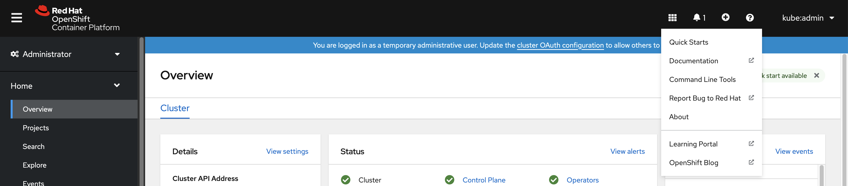
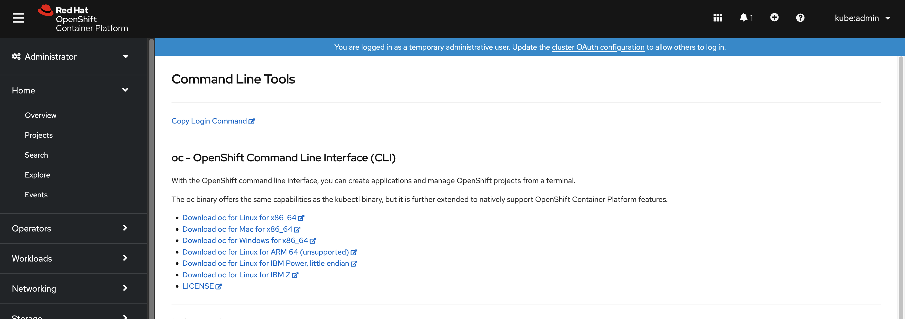
Application Deployment ARO CLI
With the OpenShift command-line interface (CLI), the oc command, you can create applications and manage OpenShift Container Platform projects from a terminal, and installation is easy!
Notes:
For each challenge, list out the key high-level goals.
If there are important specifications, list them here, or remind students to “read the student guide!”

Slide 36
Application Deployment ARO CLI
With the OpenShift command-line interface (CLI), the oc command, you can create applications and manage OpenShift Container Platform projects from a terminal.
The oc command helps both cluster administrators and developers to perform end-to-end operations using the terminal and allows the user to work directly with the project source code using command scripts.
Most oc commands are invoked using
oc <action> <object-type> <object-name>
Notes:
For each challenge, list out the key high-level goals.
If there are important specifications, list them here, or remind students to “read the student guide!”

Slide 37
Application Deployment ARO CLI
The oc binary offers the same capabilities as the kubectl binary, but it extends to natively support addition features, including:
Full support for OpenShift Container Platform resources, such as objects like DeploymentConfig, BuildConfig, Route, ImageStream, and ImageStreamTag, that are specific to OpenShift distributions
Authentication to allow you to work projects with only authenticated users
Additional commands like oc new-app to make it easier to get applications started
Notes:
For each challenge, list out the key high-level goals.
If there are important specifications, list them here, or remind students to “read the student guide!”

Slide 38
Application Deployment ARO CLI
The ARO CLI exposes commands for managing your applications, as well as lower-level tools to interact with each component of your system
$ oc login https://127.0.0.1.8443 –token=<hidden>
Logs into developer console on CLI
$ oc new-project <project-name>
Creates a new project
​
$ oc project <project-name>​
Switches between projects
​
$ oc status
Shows a high-level overview of the current project
$ oc config view
How to view the current CLI configuration file
Notes:
https://access.redhat.com/documentation/en-us/openshift_container_platform/4.2/html/builds/understanding-image-builds#builds-about_understanding-image-builds

Slide 39
Application Deployment ARO CLI
oc expose <object-type> <object-name>
looks up a service and exposes it as a route, and also has the ability to expose a deployment configuration, replication controller, service, or pod as a new service on a specified port.
oc get routes –o yaml <resource-name>
verifies the route to your application has been created
Notes:
For each challenge, list out the key high-level goals.
If there are important specifications, list them here, or remind students to “read the student guide!”

Slide 40
Application Deployment ARO CLI
Creating a new project and application can be as easy as:
oc new-project my-project
oc new-app my-apps-repo
and viewing pods and logs can use the oc commands:
oc logs app-name
oc get pods
oc status
Notes:
For each challenge, list out the key high-level goals.
If there are important specifications, list them here, or remind students to “read the student guide!”

Slide 41
Application Deployment What are ARO Projects?
An ARO project allows a community of users to organize and manage their content in isolation from other communities. Using projects, you can organize and manage applications in isolation.
You can manage an entire project lifecycle, including:
Creating, viewing, and deleting a project
Grant or revoke access to a project
Manage cluster roles for users
Prevent authenticated user groups from self-provisioning new projects
Notes:
For each challenge, list out the key high-level goals.
If there are important specifications, list them here, or remind students to “read the student guide!”

Slide 42
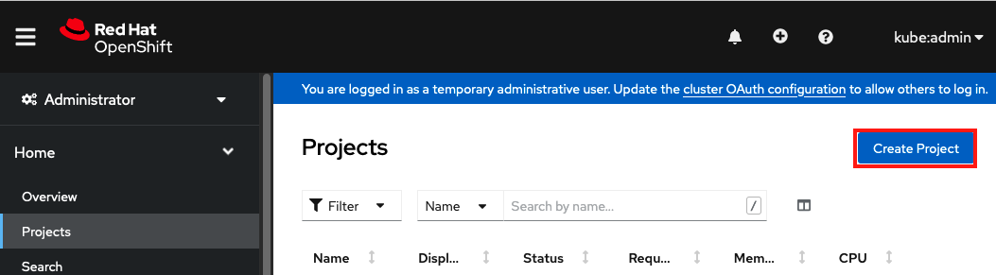
Application Deployment ARO Projects
ARO’s web console provides an easy way to organize and manage resources associated with your application like pods, services, and routes
Notes:
For each challenge, list out the key high-level goals.
If there are important specifications, list them here, or remind students to “read the student guide!”

Slide 43
Image Build Options OpenShift options
Docker Build
Builds an application from a dockerfile (dockerfile builds Docker Image, which then can be used to run a containerized application)
Source-to-Image (S2I) Build
Builds an application (and application image) from source code
Custom Build
Builds an application from a custom build script
Pipeline Build
Build that is executed as part of a Jenkins pipeline
Notes:
https://access.redhat.com/documentation/en-us/openshift_container_platform/4.2/html/builds/understanding-image-builds#builds-about_understanding-image-builds

Slide 44
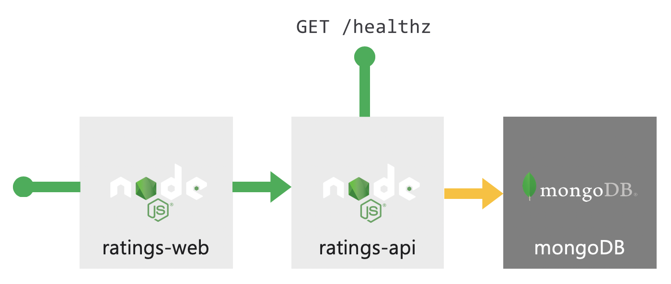
Challenge #2 Let’s deploy an application to our cluster!
Deploy the sample application to the ARO cluster
Deploy the application’s frontend
Deploy the application’s backend
View your application’s homepage on a browser!
Notes:
For each challenge, list out the key high-level goals.
If there are important specifications, list them here, or remind students to “read the student guide!”

Slide 45
Logging and Metrics
Notes:
For each “mini-lecture”, have a topic title and/or sub-topic title.
Each mini-lecture should be no longer than 5-10 minutes in length.
Only deliver one lecture ahead of each challenge.
Do not attempt to present all of the lectures before students start hacking.

Slide 46
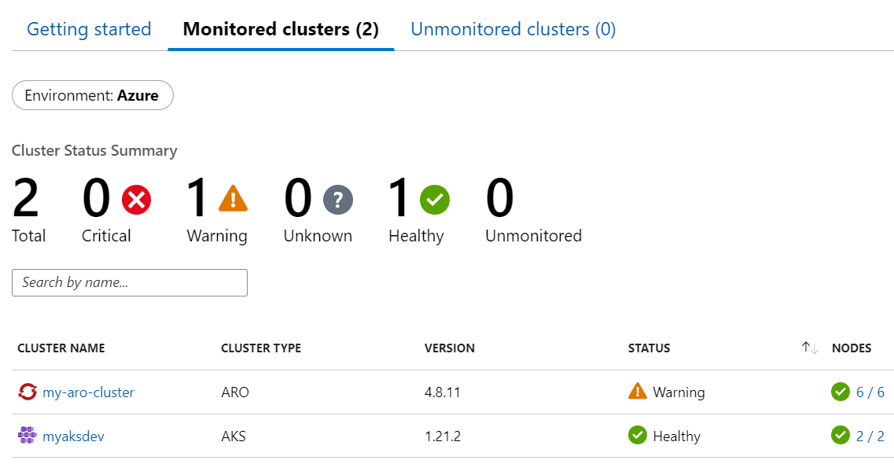
Monitoring Monitoring in ARO
Cluster monitoring in Azure Portal with Container Insights.
Built-in monitoring with Prometheus Operator in the ARO console.
Application logs are also collected as a part of the monitoring process.
Notes:
Can use both Azure Monitor or the web console, mostly about preference

Slide 47
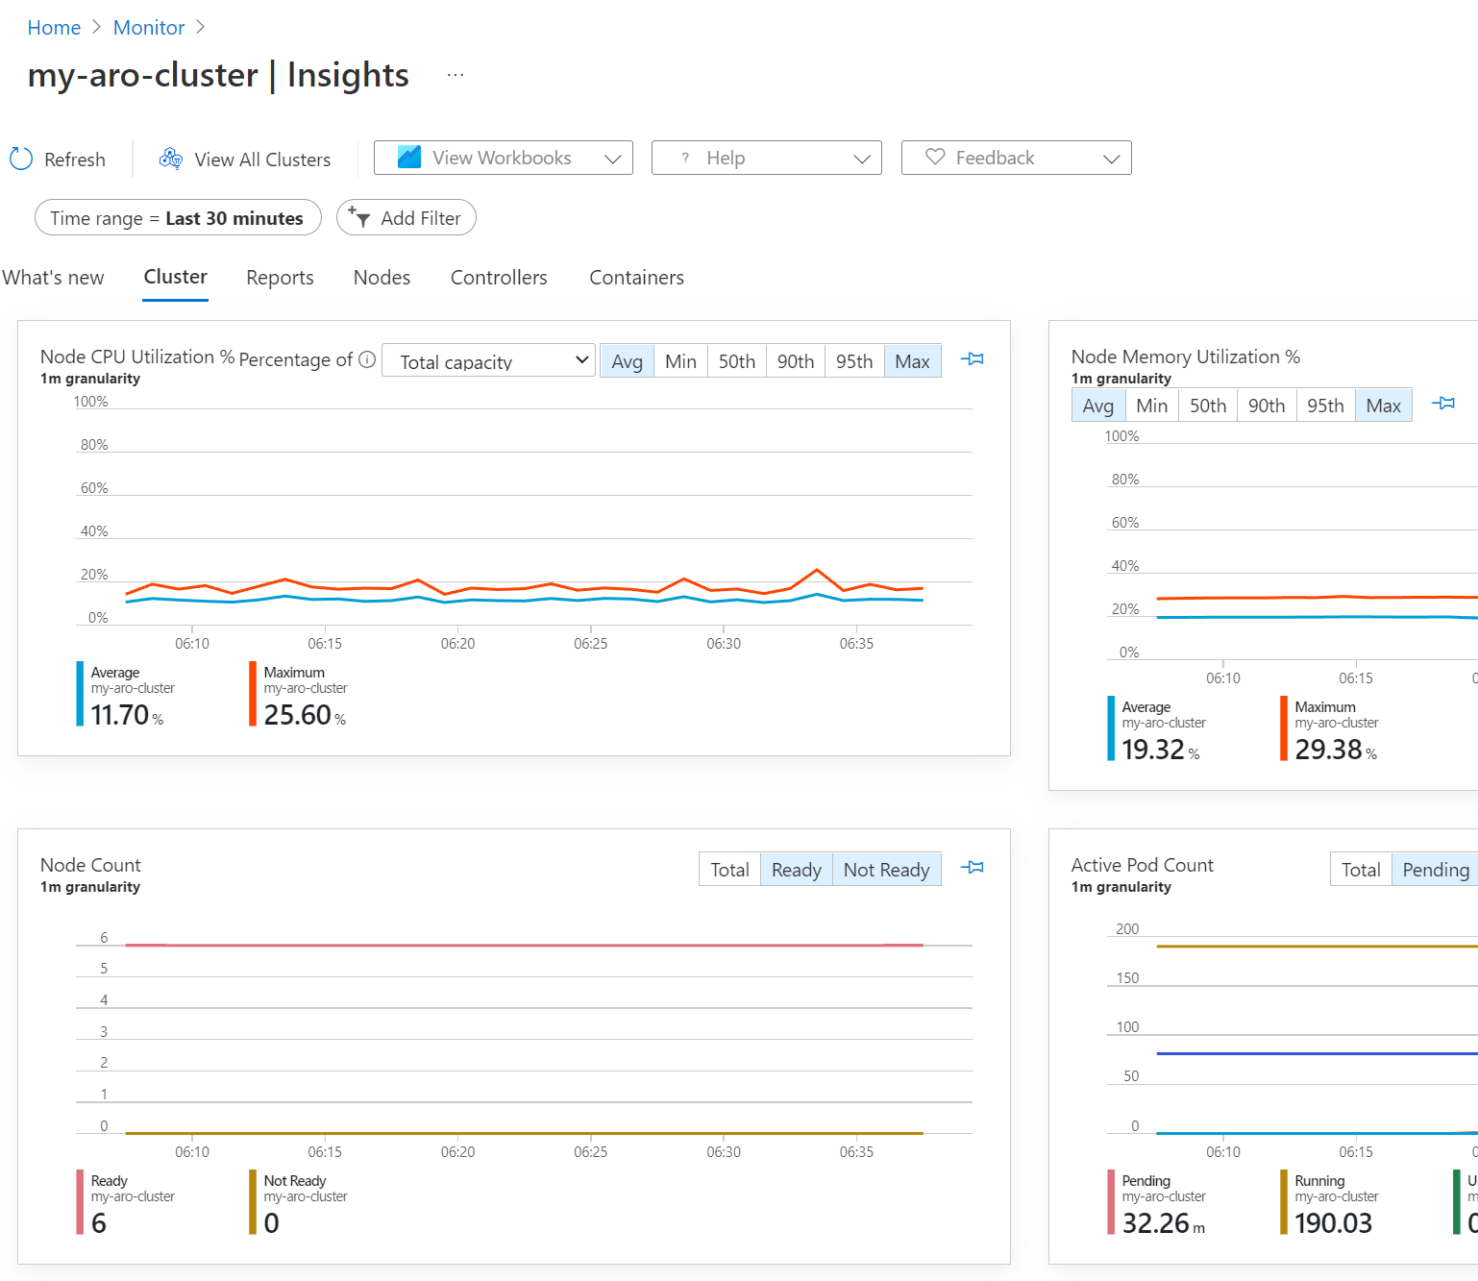
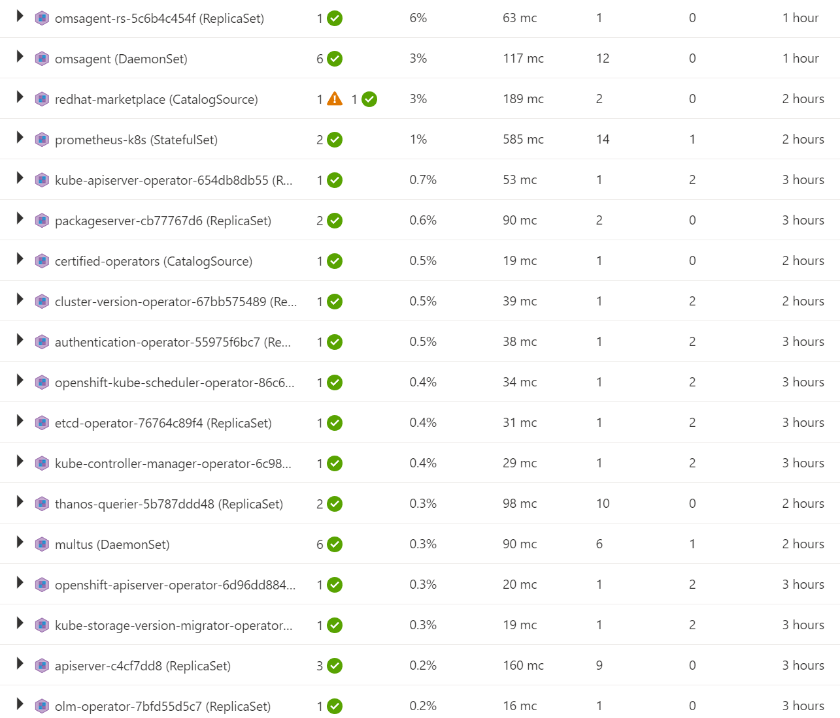
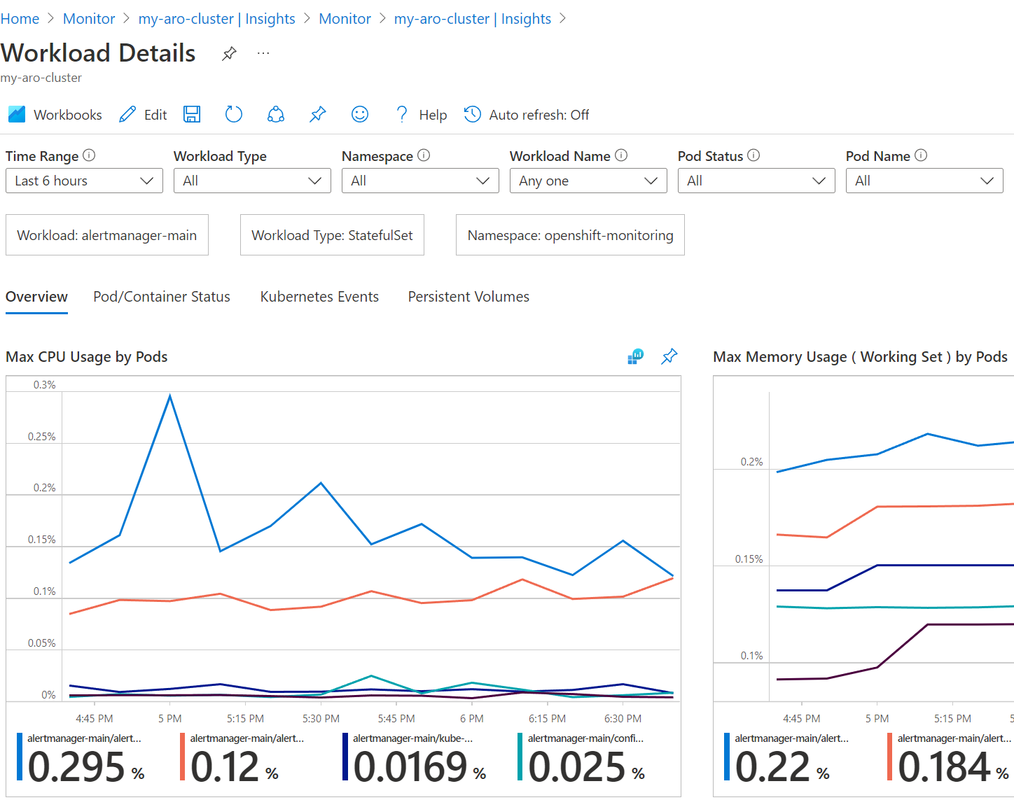
Monitoring Container Insights
Cluster’s memory and CPU metrics
Pod status and high-level metrics
Drill into Pods for more details
Get instant feedback from dashboards inside of Container Insights.
Review the overall status of Controllers and Pods.
Get more detailed CPU and memory metrics of current workloads in the cluster.
Notes:
Have to use Arc for K8s to get the Azure monitoring integrated with ARO

Slide 48
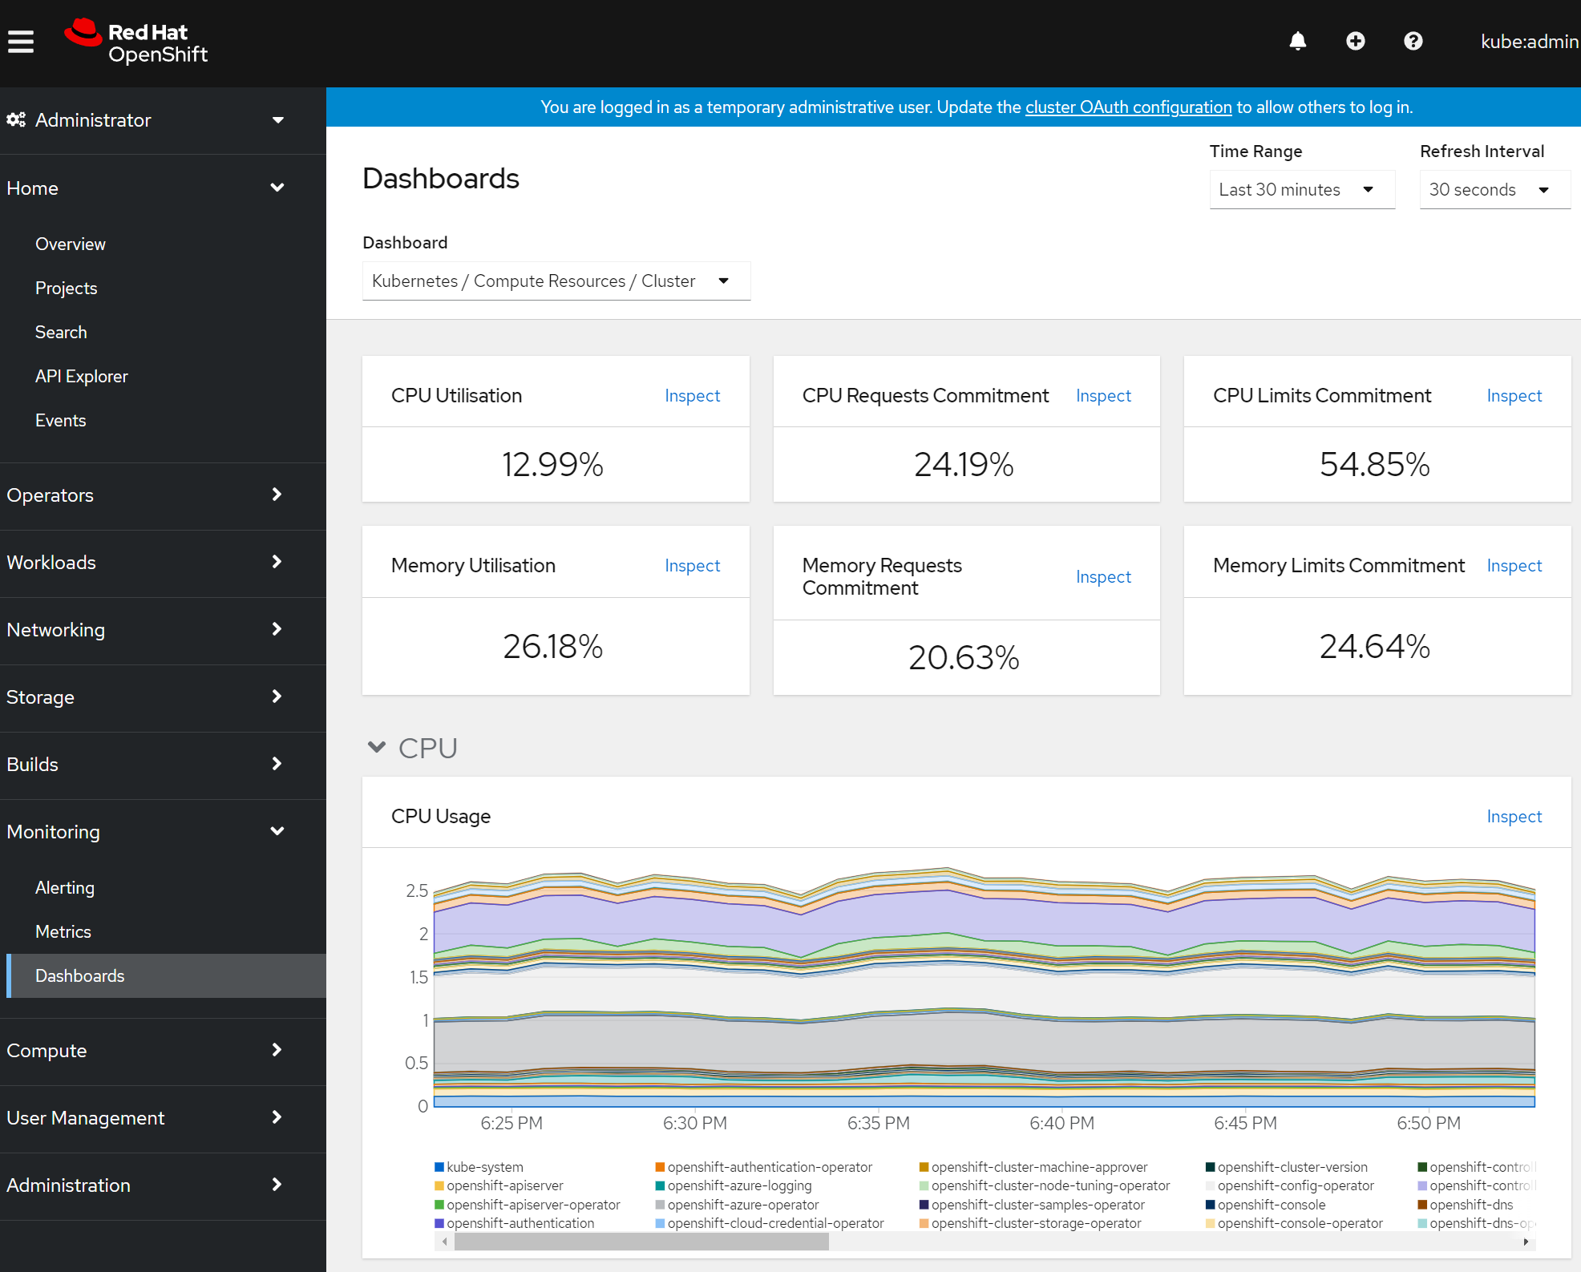
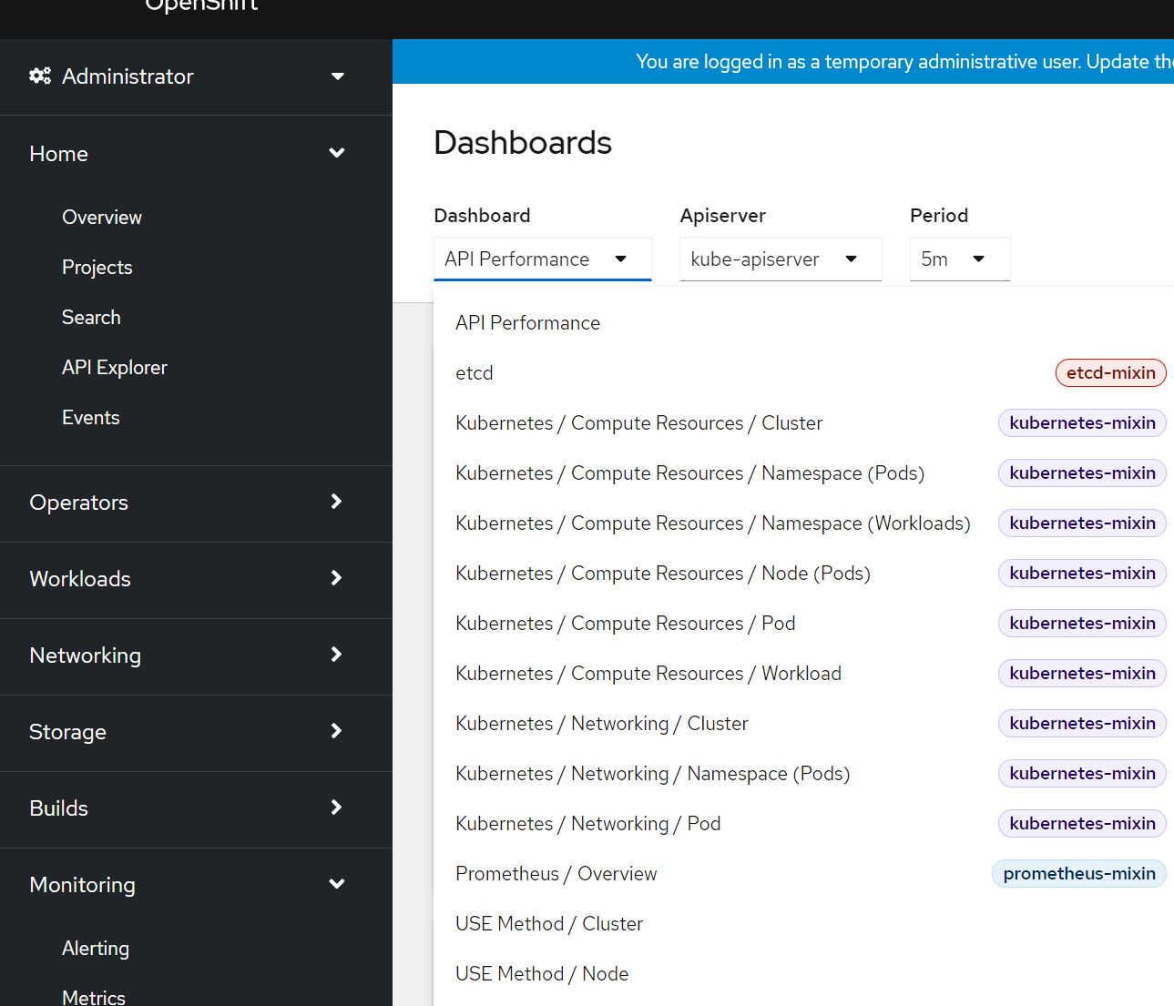
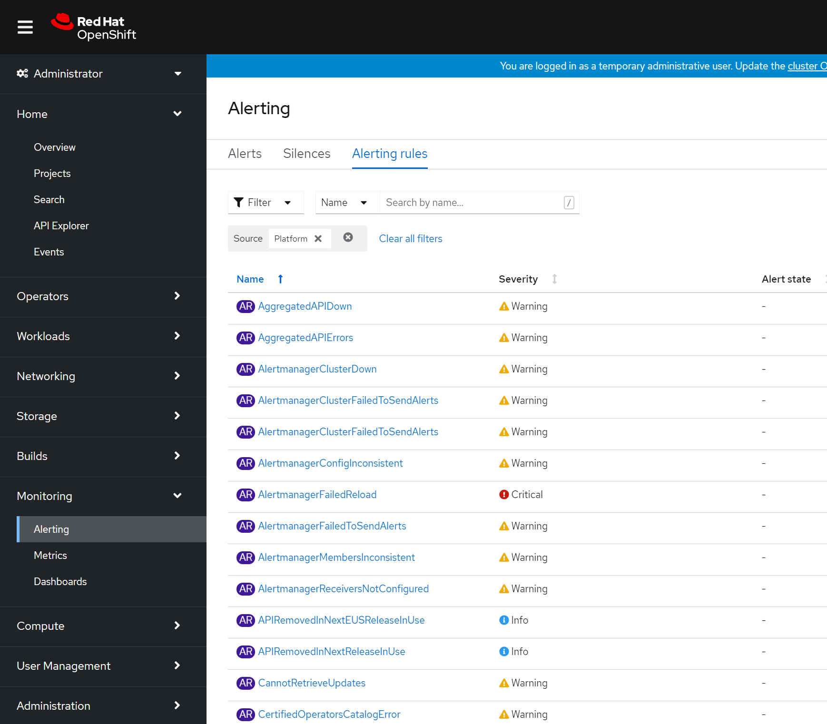
Monitoring ARO Analytics Dashboards
Cluster’s memory and CPU from console
Predefined set of dashboards
Predefined set of Alerts
Get a quick overview of overall performance metrics right there in the console without additional configuration.
Most useful dashboards for monitoring the cluster comes pre-installed.
Alerts are also pre-configured and accessible from ARO’s console.
Notes:
Default monitoring with OS using Prometheus

Slide 49
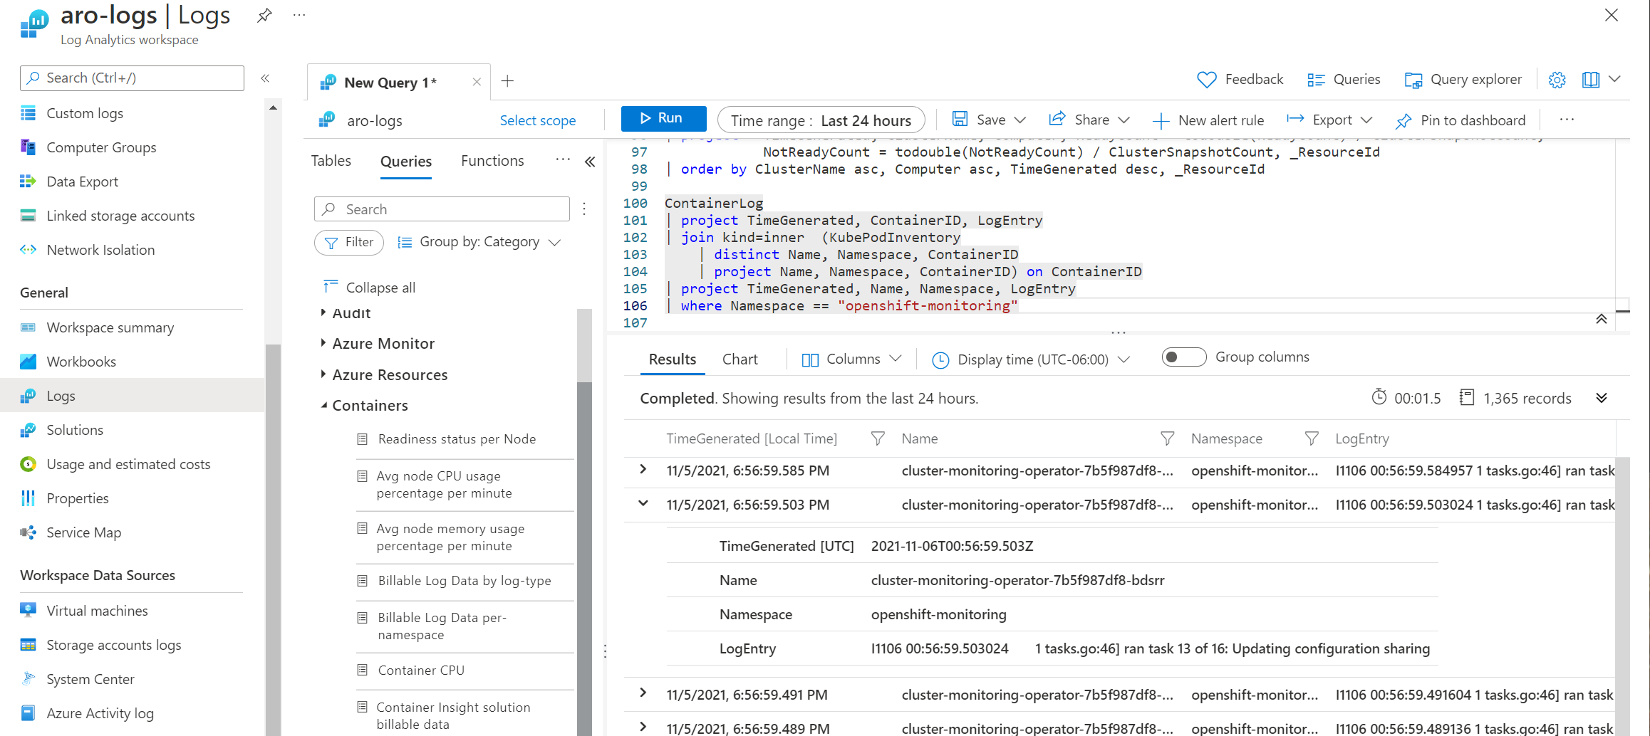
Monitoring Log Analytics
Notes:
Deeper insights and advanced customization features with log analytics

Slide 50
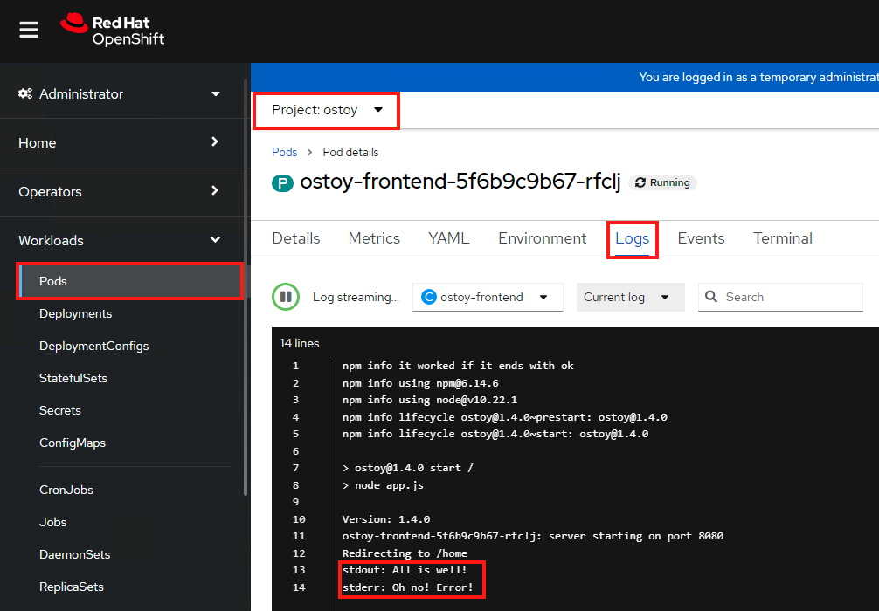
Logging View Logs
Notes:
Deeper insights and advanced customization features with log analytics

Slide 51
Challenge #3 Let’s explore logs and metrics!
Identify application errors using logging and metrics
View logs in both the CLI and on the ARO console
Explain how the application is broken
Optional: Integrate ARO with Azure Monitor to see Container Insights
Notes:
For each challenge, list out the key high-level goals.
If there are important specifications, list them here, or remind students to “read the student guide!”

Slide 52
Storage
Notes:
For each “mini-lecture”, have a topic title and/or sub-topic title.
Each mini-lecture should be no longer than 5-10 minutes in length.
Only deliver one lecture ahead of each challenge.
Do not attempt to present all of the lectures before students start hacking.

Slide 53


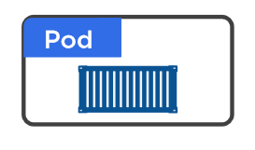
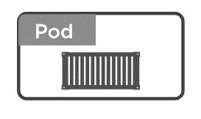
Volumes in Azure RedHat OpenShift
Why we need to volumes ?
On-disk files in a Container
are
ephemeral
Volume
(state)
Notes:
2 clicks
If pods dies, data dies
Pods only get ephemeral storage
What happens if you need persistence across lifecycle
VOLUMES!

Slide 54
Volumes in Azure RedHat OpenShift
Different Types
Volumes
emptyDir
hostPath
Cloud Volumes
Persisted Volum Claim (PVC)
ConfigMap
Security
….
RAM
HDD /SSD
Notes:
hostPath = folder on node (single node testing only)
<click>

Slide 55
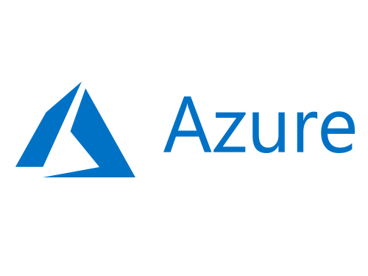

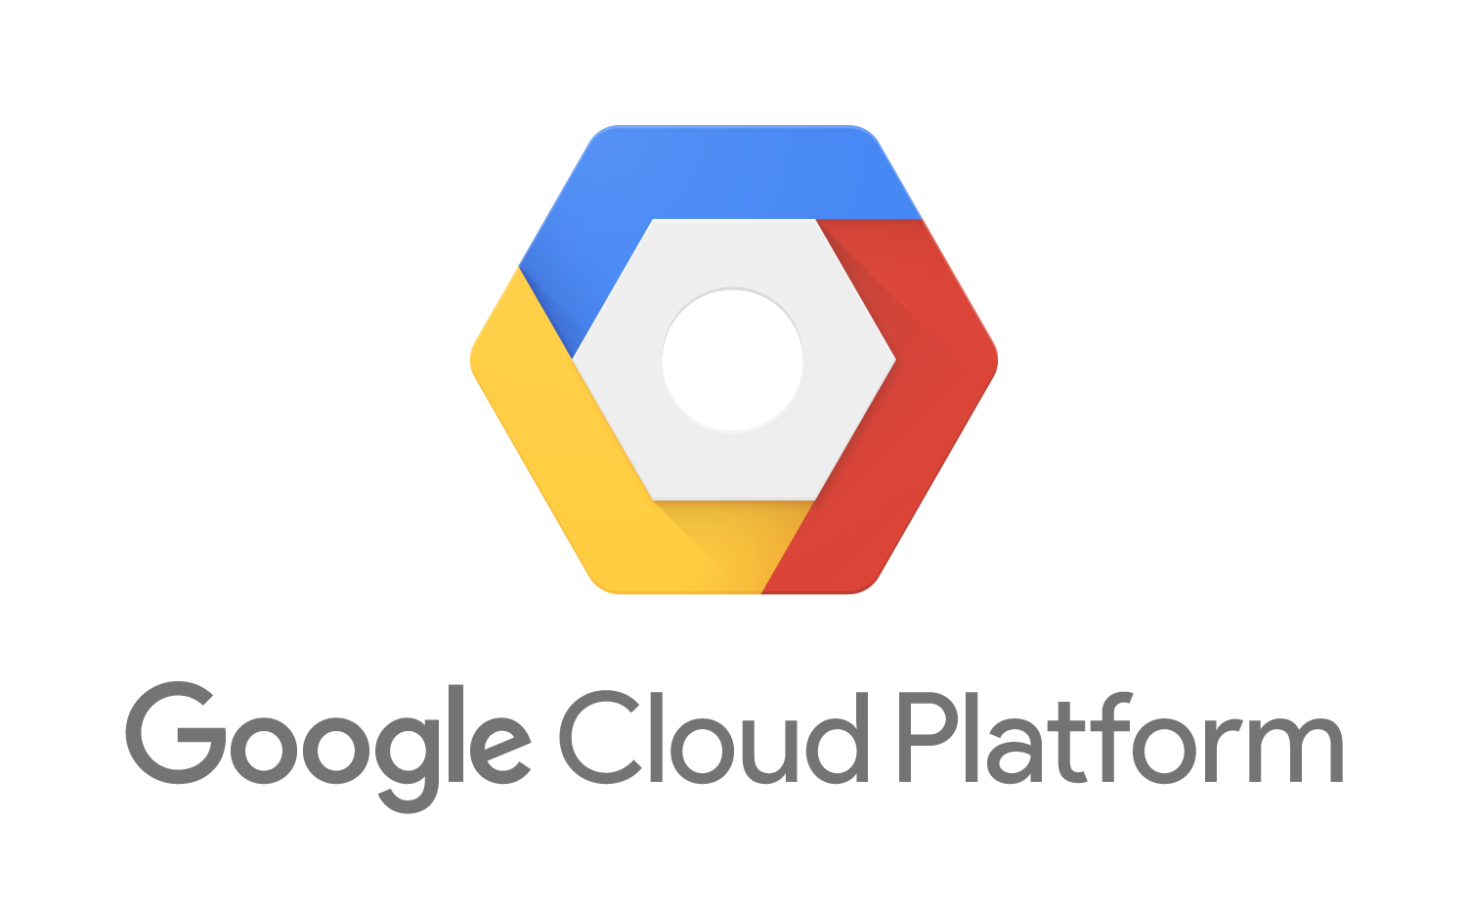
Volumes in Azure RedHat OpenShift
Different Types of Volumes
Volumes
emptyDir
hostPath
Cloud Volumes
Persisted Volum Claim (PVC)
ConfigMap
Security
….
Notes:
Cloud Volumes = storage on cloud providers: ie: Blob
<click>

Slide 56
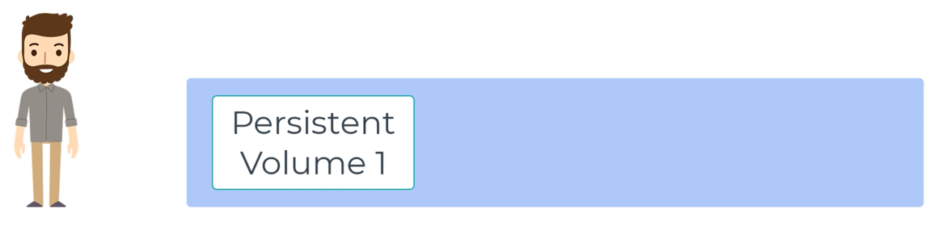
Persistent Volumes - Static
Notes:
PV is storage provisioned by admin.

Slide 57
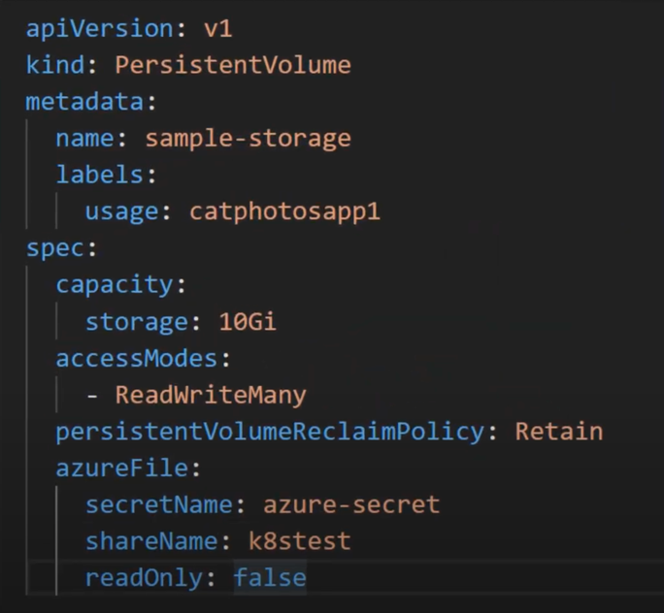
Persistent Volumes - Static
Notes:
PV is storage provisioned by admin.

Slide 58
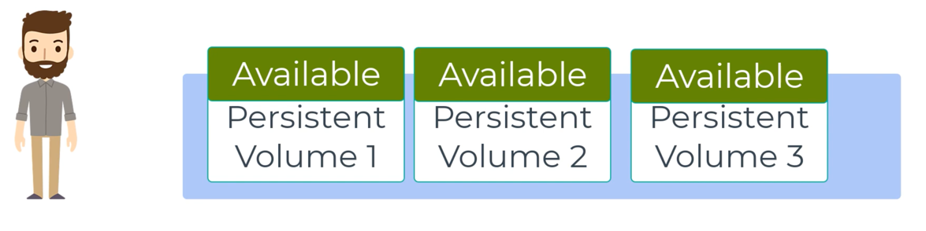
Persistent Volumes - Static
Notes:
PV is storage provisioned by admin.
Cluster of disks like we have a cluster of VMs.

Slide 59
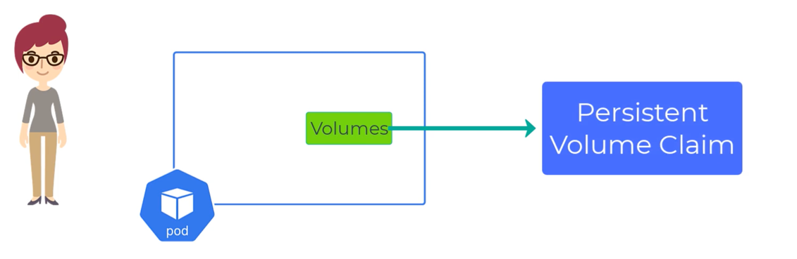
Persistent Volume Claims
Notes:
PVC is a request for storage of certain size and type
Just like: pods with their cpu and memory requests

Slide 60
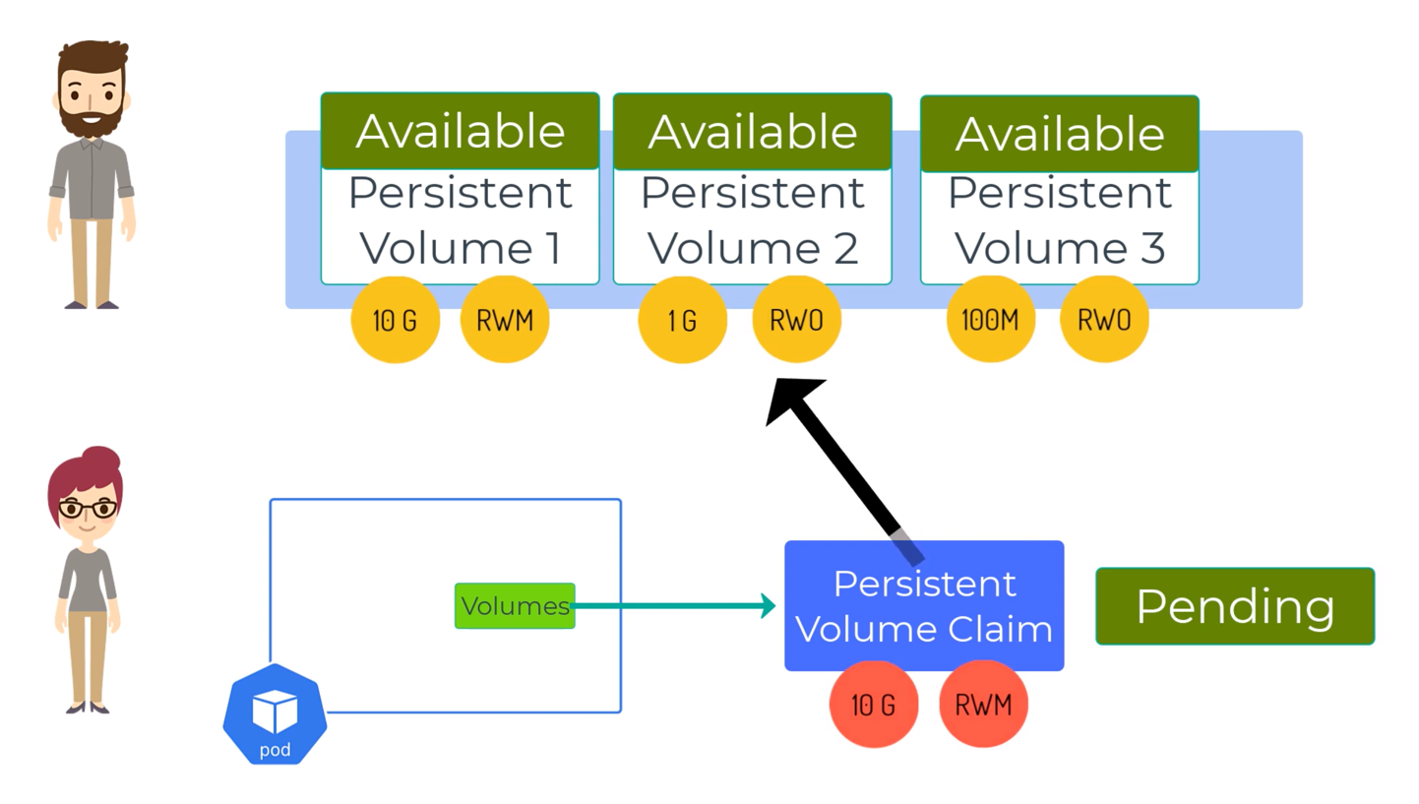
Persistent Volume Claims
Notes:
PVC will search for a PV that matches its needs.
It will remain in Pending state until it does.

Slide 61
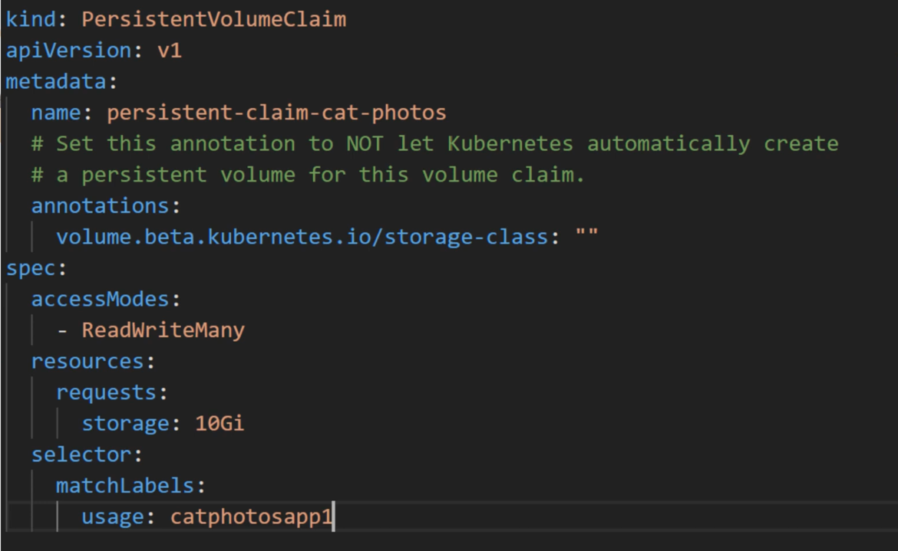
Persistent Volume Claims
Notes:
PVC is a request for storage of certain size and type
Just like: pods with their cpu and memory requests

Slide 62
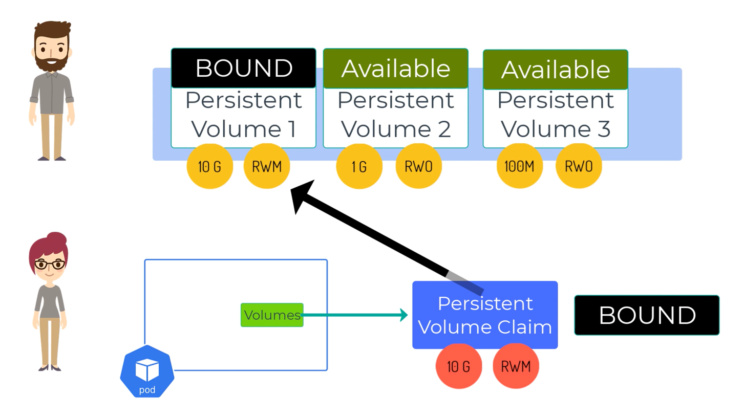
Persistent Volume Claims
Notes:
Once a suitable PV is found, the PVC is “Bound” to the PV

Slide 63
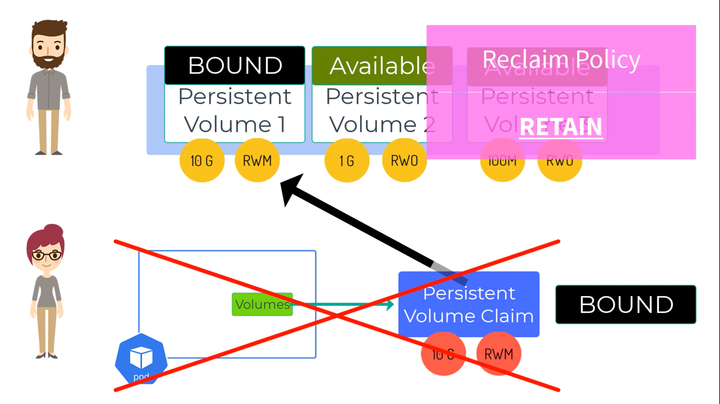
Persistent Volume Claims
Notes:
The reclaim policy tells us what happens to the PV when the PVC is deleted

Slide 64
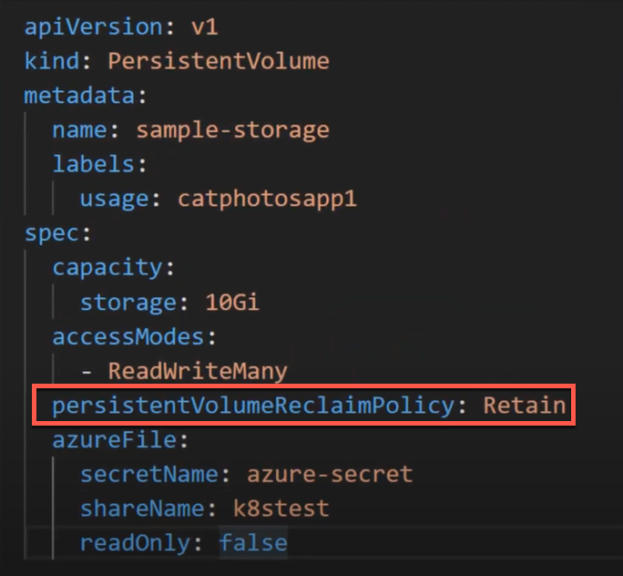
Persistent Volume Claims
Notes:
The reclaim policy tells us what happens to the PV when the PVC is deleted.
Cluster admin set this when they set up the PV cluster.

Slide 65
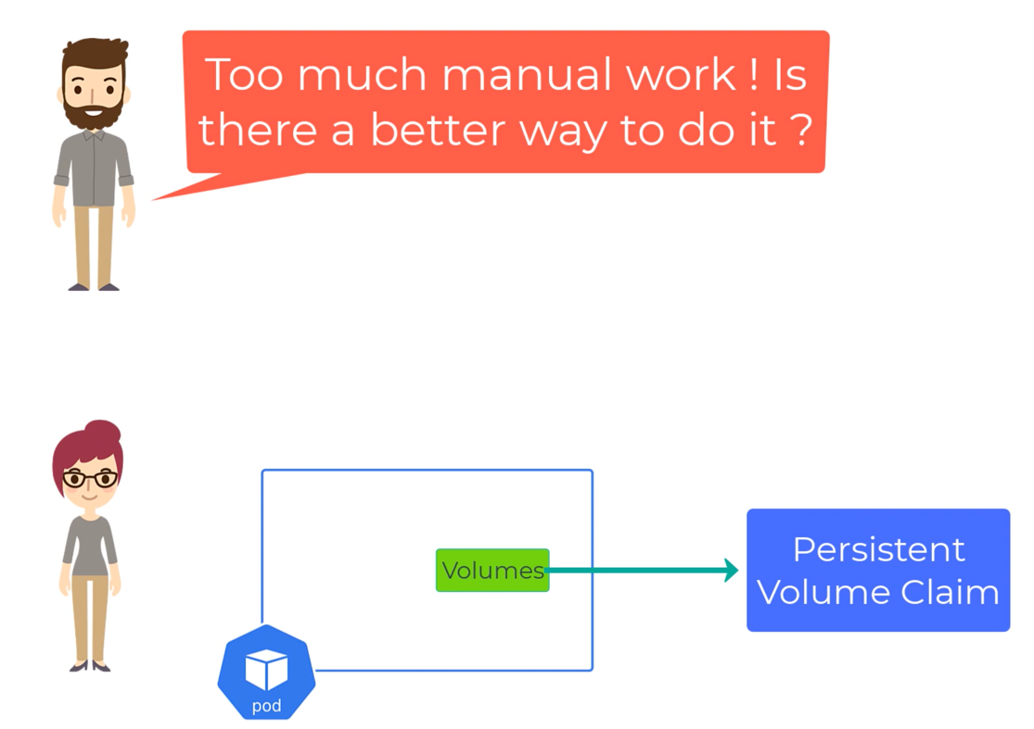
Persistent Volumes
Notes:
How do we make this more dynamic???

Slide 66
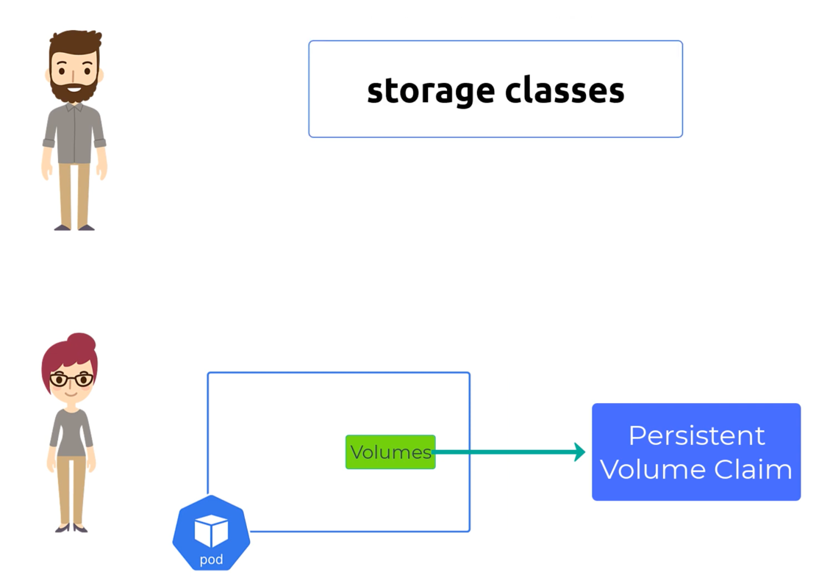
Persistent Volumes - Dynamic
Notes:
… storage classes.

Slide 67
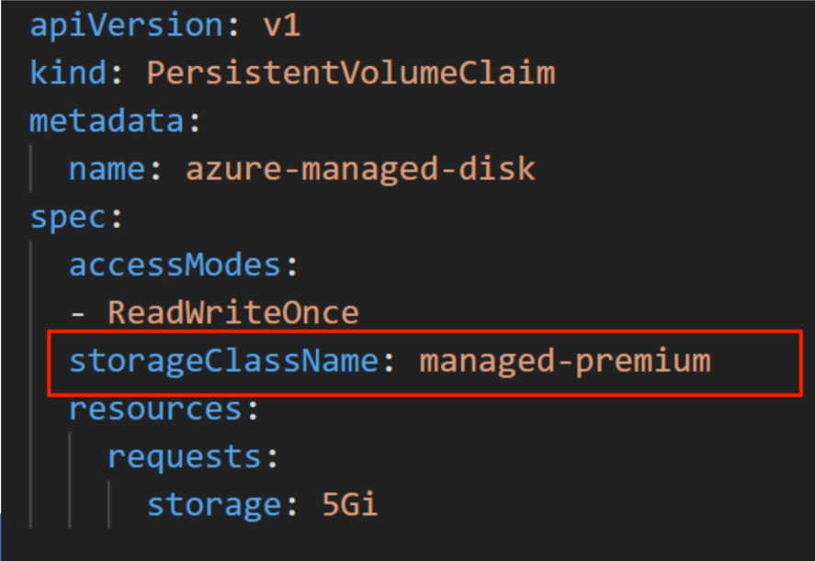
Persistent Volumes - Dynamic
Notes:
When we create a PVC with a storage class, the SC will make sure to dynamically create the type of storage we want.

Slide 68
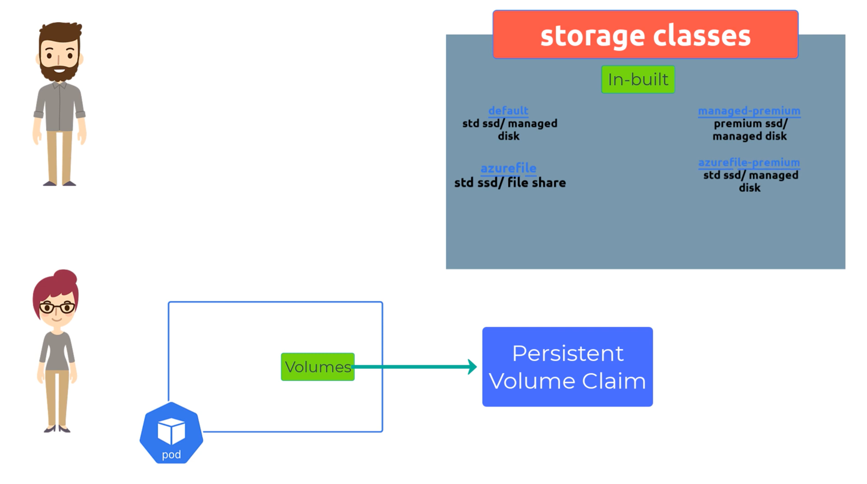
Persistent Volumes - Dynamic
Notes:
There are various storage clusters that come with AKS and more can be created.

Slide 69
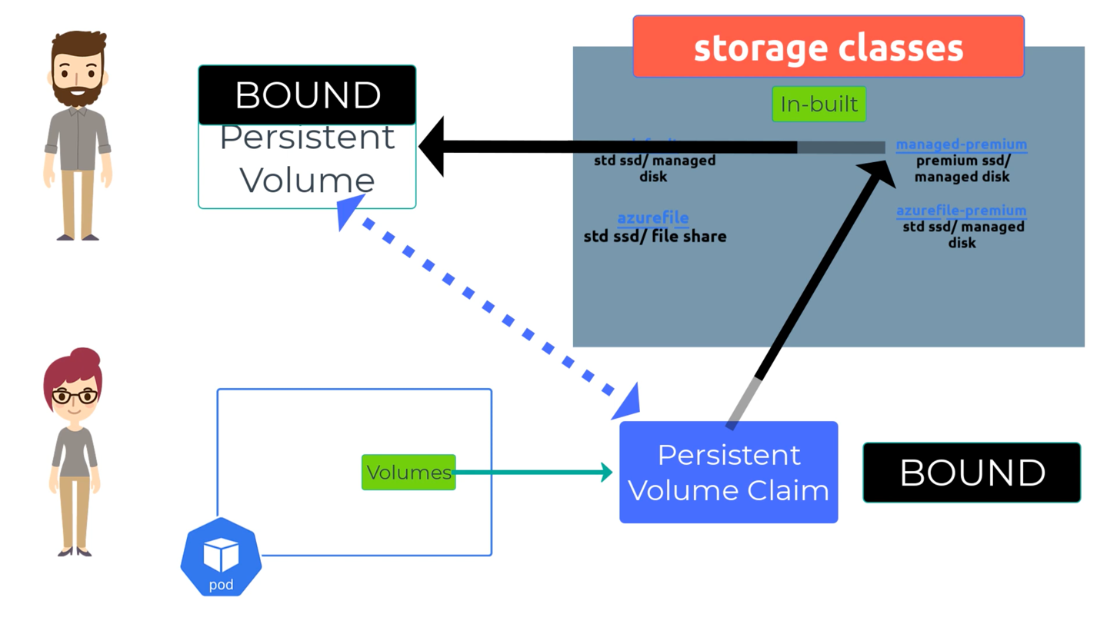
Persistent Volumes - Dynamic
Notes:
Once the PV asks for a managed-premium disk it is provisioned automatically
Ops doesn’t need to be involved.
It will be the exact size asked for
The default retainPolicy is “DELETE”

Slide 70
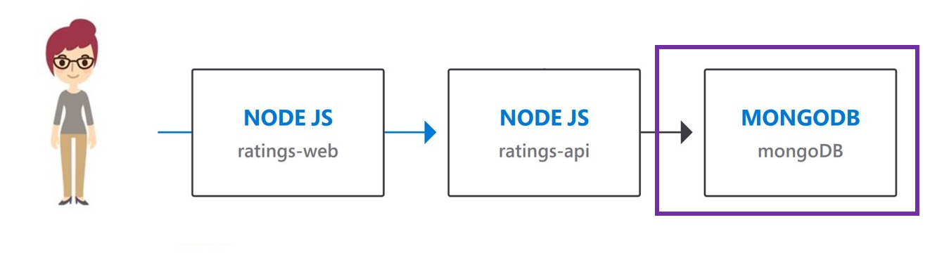
Challenge #4 Let's deploy a database!
Deploy a MongoDB service
Identify the MongoDB service's hostname and have it saved for the next challenge
Identify the rating-api service's hostname and have it saved for the next challenge
Notes:
For each challenge, list out the key high-level goals.
If there are important specifications, list them here, or remind students to “read the student guide!”

Slide 71
Configuration
Notes:
For each “mini-lecture”, have a topic title and/or sub-topic title.
Each mini-lecture should be no longer than 5-10 minutes in length.
Only deliver one lecture ahead of each challenge.
Do not attempt to present all of the lectures before students start hacking.

Slide 72
Configuration Why Environment Variables?
Environment Variables are a way to move application and infrastructure configuration outside of application code
Environment variables is to enable easier switching between environments. If we want to point our rating-web to a different backend, we can with environment variables. If we want to use a different database, we can just change our environment variables to point at a different database
Environment variables decouple applications making future changes easier

Slide 73
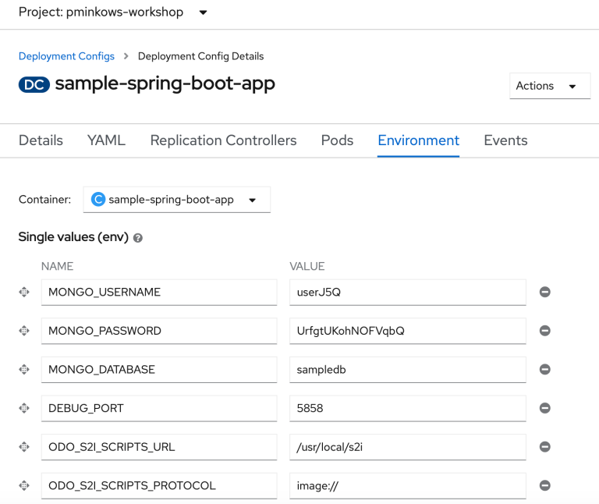

Configuration Environment Variables in ARO
OpenShift Container Platform provides the oc set env command to set or unset environment variables for objects that have a pod template, such as deployment configurations
Another way to set or unset environment variables is by using the ARO Web Console. The ARO Web Console is great for those who don’t want to use the command line when managing ARO configuration
oc set env deploy math-application PI=3.14

Slide 74
Configuring Deployments
A deployment is metadata. It's just metadata!
Metadata that describes how resources are configured.
deployment
deployment
rating-web
name | app=rating-web
containers | /rating-web
container-port | 80
env
rating-api
name | app=rating-api
containers | /rating-api
container-port | 8080
env | MONGODB_URI=…
PI=3.14
oc set env deploy rating-web PI=3.14
Notes:
Deployments are metadata that define how the pods and their containers will be hosted.
What is that metadata
Image – link to the container registry & container name
Port – port number this pod should listen to traffic on
Storage/resources
Label=important => Labels are the most important concept in Kubernetes.
An example is API=/sample/api. This would point the ratings-web to the backend API in its environment variables Kubernetes keeps a database of all of the configuration information. The “label” you give to a Pod makes it possible for Kubernetes to keep track of all instances of that type of pod running in the cluster.

Slide 75
Challenge #5 Configuration
Configure the deployments
Your goal is to find out what deployments and environment variables need to be configured for our application to work
Demonstrate that the application is working
Notes:
For each challenge, list out the key high-level goals.
If there are important specifications, list them here, or remind students to “read the student guide!”

Slide 76
Networking Pod Traffic and Policies
Notes:
For each “mini-lecture”, have a topic title and/or sub-topic title.
Each mini-lecture should be no longer than 5-10 minutes in length.
Only deliver one lecture ahead of each challenge.
Do not attempt to present all of the lectures before students start hacking.

Slide 77
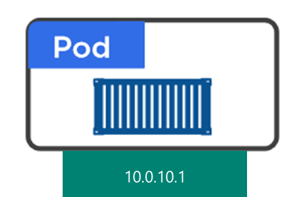



Networking Pod Traffic
By default, all pods in a project are accessible from other pods and network endpoints.

Slide 78
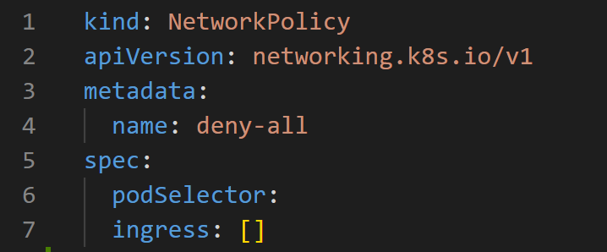
Networking Network Policies
To isolate one or more pods in a project, you can create NetworkPolicy objects in that project to indicate the allowed incoming connections. For example, to make a project deny all traffic by default, you would create a network policy

Slide 79
Networking Network Policies
To apply a Network Policy, you would use an OC CLI command and apply the Network Policy yaml file just like any other resource file

Slide 80
Challenge #6 Let's deploy some Network Policies!
Block all traffic by default to all pods in your project
Allow traffic to the rating-web frontend application
Allow traffic to the rating-api backend application
Notes:
For each challenge, list out the key high-level goals.
If there are important specifications, list them here, or remind students to “read the student guide!”

Slide 81
Scaling Scaling your deployments
Notes:
For each “mini-lecture”, have a topic title and/or sub-topic title.
Each mini-lecture should be no longer than 5-10 minutes in length.
Only deliver one lecture ahead of each challenge.
Do not attempt to present all of the lectures before students start hacking.

Slide 82
Scaling Deployments
Cluster
Control Plane
Node
Node
Node
Kube stuff
Kube stuff
Kube stuff
Kube stuff
Pod
ratings-web1
Pod
ratings-web3
Pod
ratings-web5
*Azure Managed
Deployment
SCALE pods!
Pod
ratings-web2
Pod
ratings-web4
Pod
ratings-web6
oc scale deployment ratings-web replicas=6
Notes:
OpenShift allows one to scale up/down the number of pods for each part of an application as needed. This can be accomplished via changing our replicaset/deployment definition (declarative), by the command line (imperative), or via the web UI (imperative). Here we show it by command line and what happens.

Slide 83
Challenge #7 Scaling
Scale our applications
Scale the rating-api backend application to 4 pods
Scale the rating-web frontend application to 2 pods
Optional: Implement Pod Autoscaling
Notes:
For each challenge, list out the key high-level goals.
If there are important specifications, list them here, or remind students to “read the student guide!”

Slide 84
Azure Active Directory Integrate Azure AD with ARO
Notes:
For each “mini-lecture”, have a topic title and/or sub-topic title.
Each mini-lecture should be no longer than 5-10 minutes in length.
Only deliver one lecture ahead of each challenge.
Do not attempt to present all of the lectures before students start hacking.

Slide 85
Azure Active Directory Integration
What is Azure AD?
A multi-tenant service that provides enterprise-level identity and access management for the cloud.
Built to support global scale, reliability and availability.
Backed by a 99.99% SLA for Azure AD Premium or Basic
What can I do with it?
Manage users and access to cloud resources.
Extend your on premise Active Directory to the cloud.
Provide single-sign-on (SSO) across your cloud applications.
Reduce risks by enabling multi-factor authentication.
Support development’s need to build secure directory integrated applications for the enterprise.

Slide 86
Azure Active Directory Integration Why use Azure AD and ARO?
Integrating Azure AD with ARO allows users to login to the ARO Web Console using their Microsoft credentials
Applications registered in an Azure Active Directory (Azure AD) tenant are, by default, available to all users of the tenant who authenticate successfully. Azure AD allows tenant administrators and developers to restrict an app to a specific set of users or security groups in the tenant

Slide 87
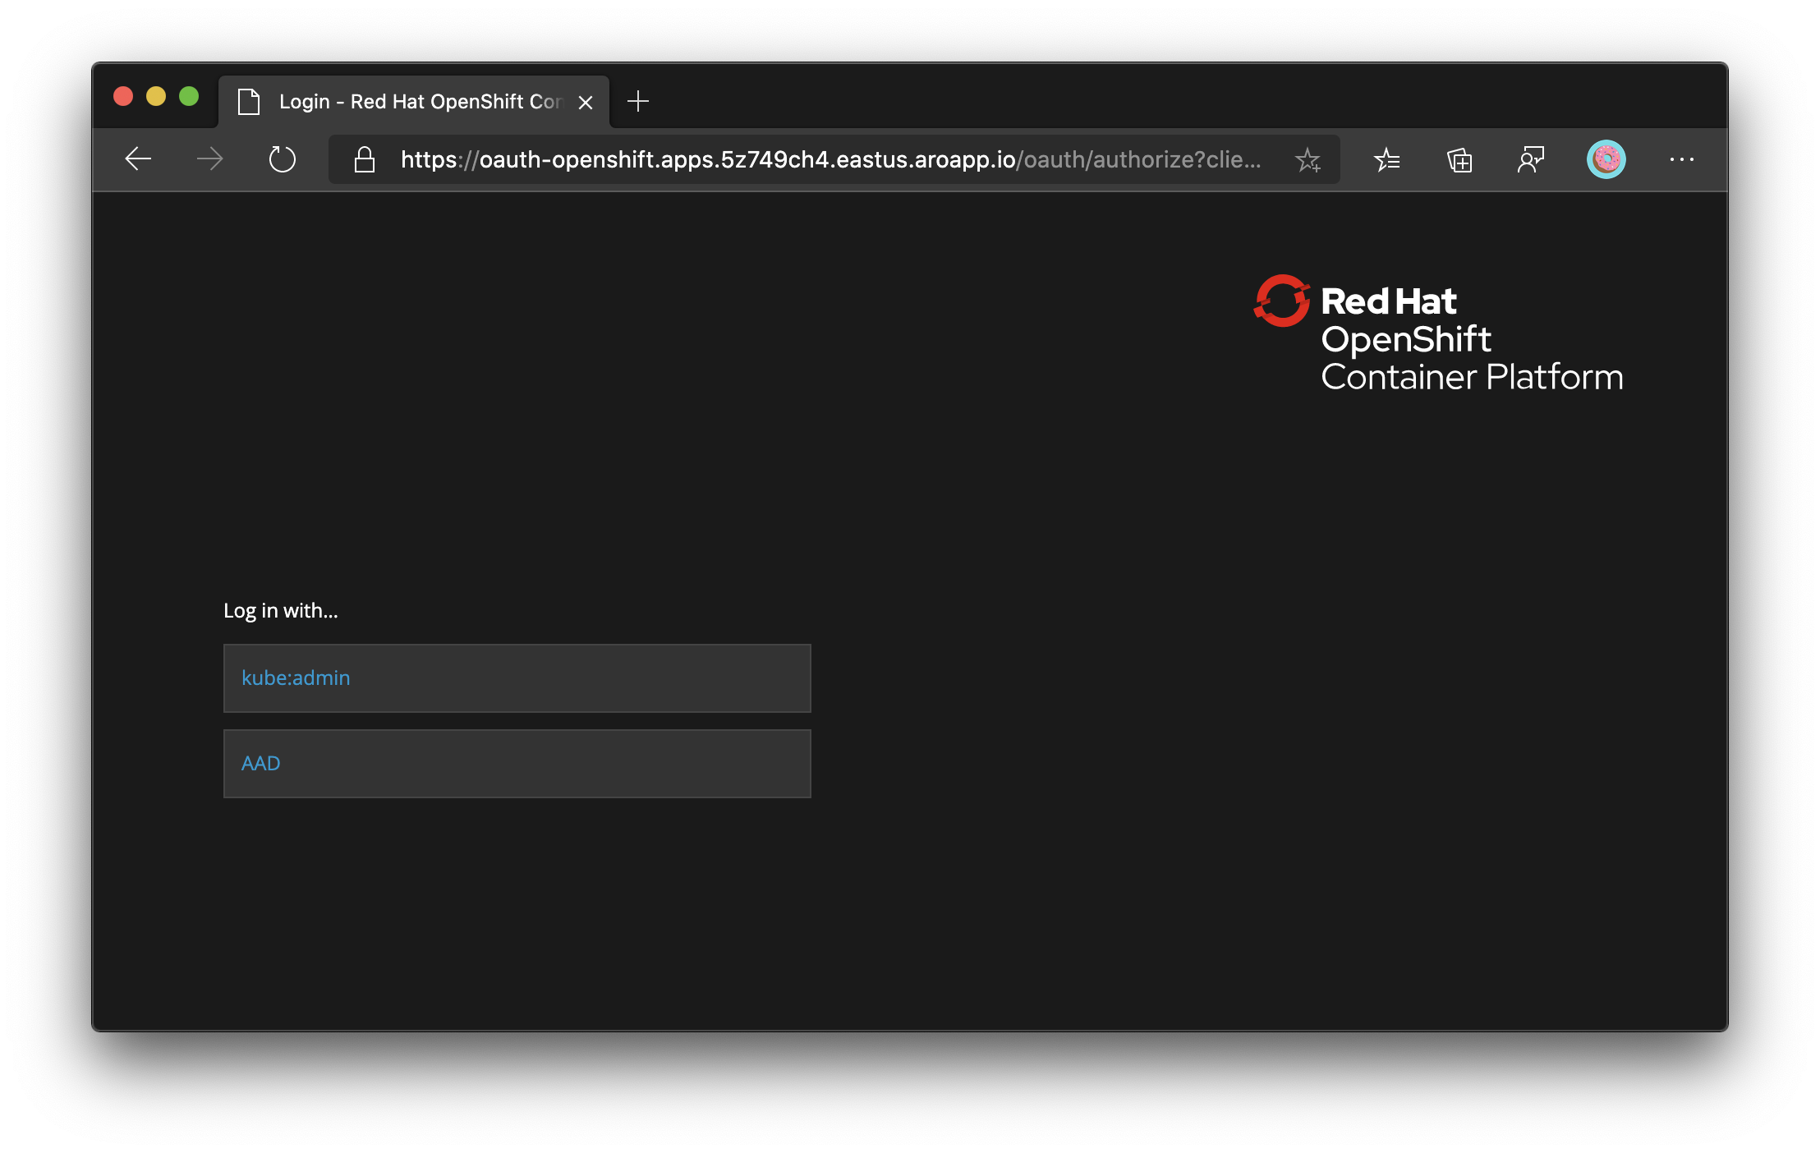
Challenge #8 Azure Active Directory Integration
Integrate Azure AD with ARO
Demonstrate that you have an option to login to the ARO Web Console using Azure AD
This is what your ARO Web Console should look like after successfully integrating Azure AD with your ARO cluster
Notes:
For each challenge, list out the key high-level goals.
If there are important specifications, list them here, or remind students to “read the student guide!”

Slide 88
Azure Service Operator Connect ARO clusters to Azure services
Notes:
For each “mini-lecture”, have a topic title and/or sub-topic title.
Each mini-lecture should be no longer than 5-10 minutes in length.
Only deliver one lecture ahead of each challenge.
Do not attempt to present all of the lectures before students start hacking.

Slide 89
Challenge #9 Azure Service Operator Connection
Install Azure Service Operator to your ARO cluster
Demonstrate that the Azure Service Operator has been installed in your ARO cluster
Notes:
For each challenge, list out the key high-level goals.
If there are important specifications, list them here, or remind students to “read the student guide!”

Slide 90
Thank You for Attending! https://aka.ms/wth
Notes:
Thank students for attending and share the link to the What The Hack website with them.

